Slide 1

St Nicholas Church School
Welcome Meeting
Friday

Slide 2

Meet the
Yeo Team
Our class team this year:
Miss King
Mrs Clarke
Mrs Smith
Mrs Wilkinson

Slide 3






School Values
Our values are the positive behaviours we expect of all members of our school community.
We make sure that all children know the school values and understand how they can demonstrate them.

Slide 4
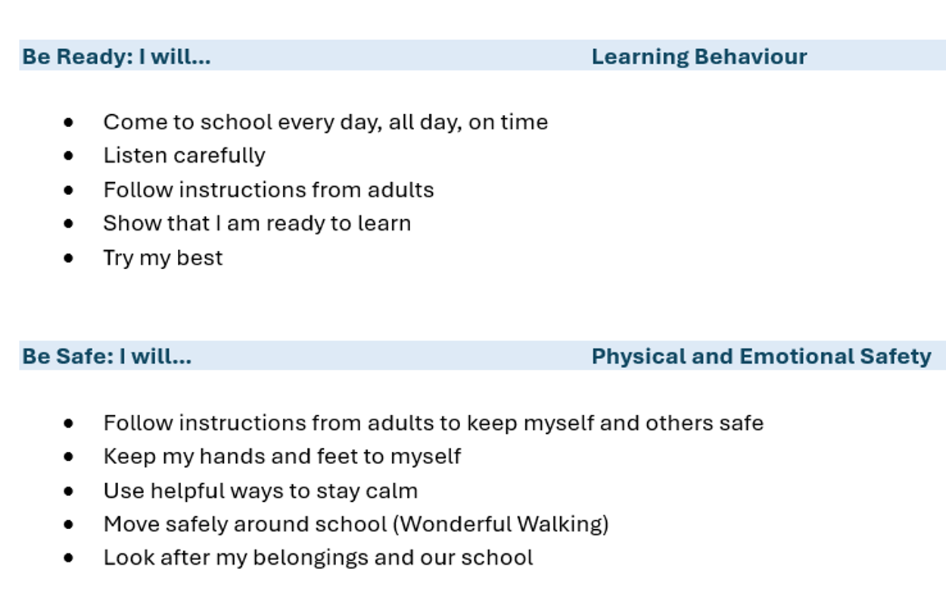
School Behaviour Curriculum
As part of our behaviour policy, we have introduced a behaviour curriculum which details the expectations of pupils in school. It can be found in our behaviour policy on the school website.
The 4 areas are:

Slide 5
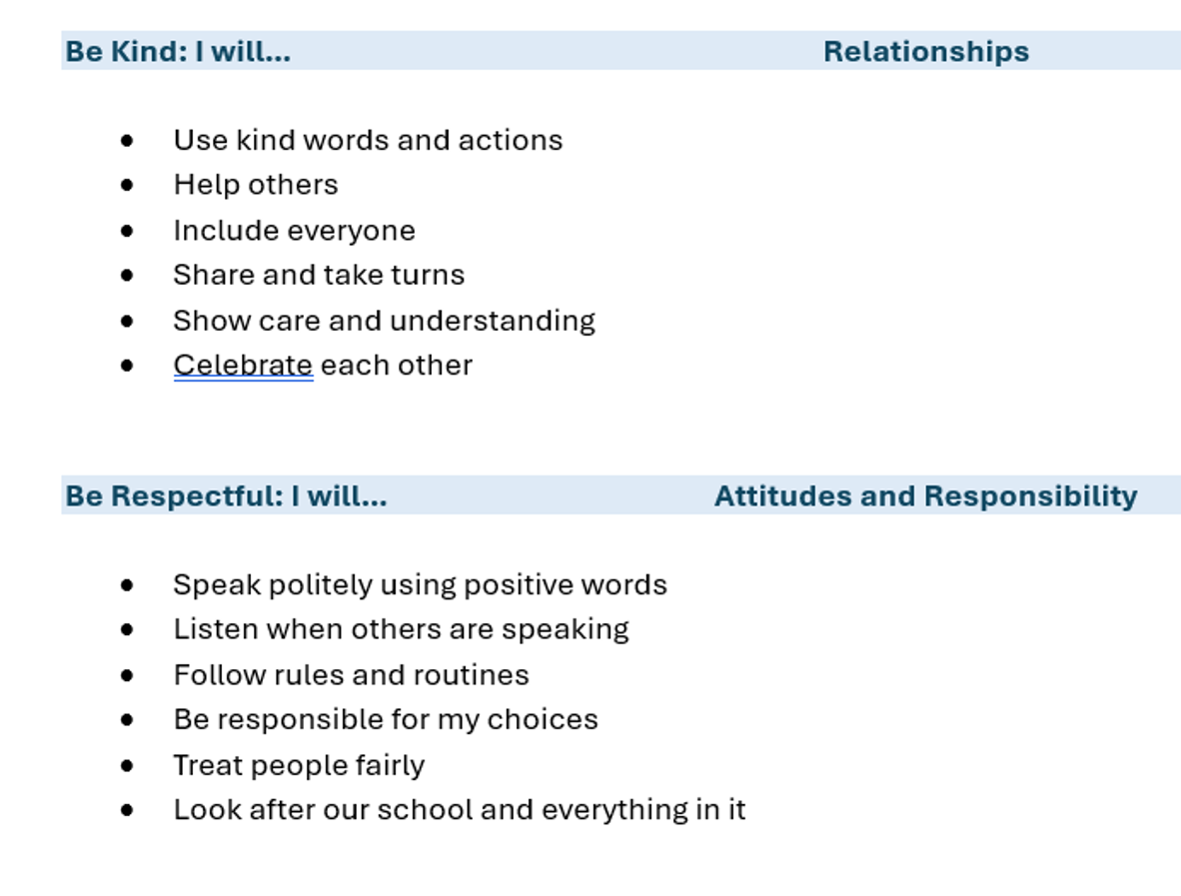
School Behaviour Curriculum

Slide 6
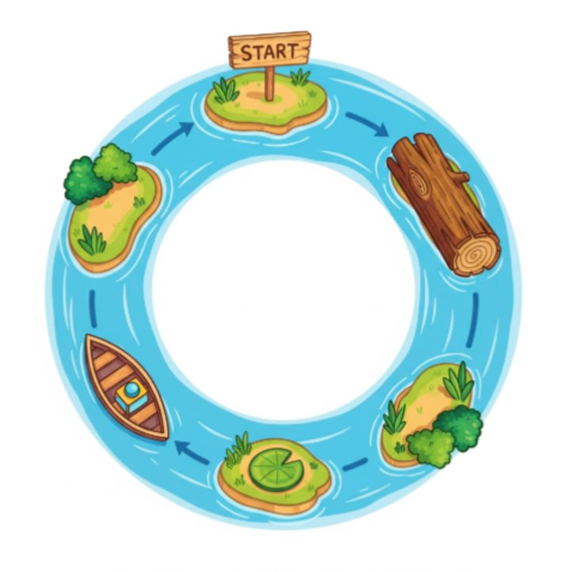
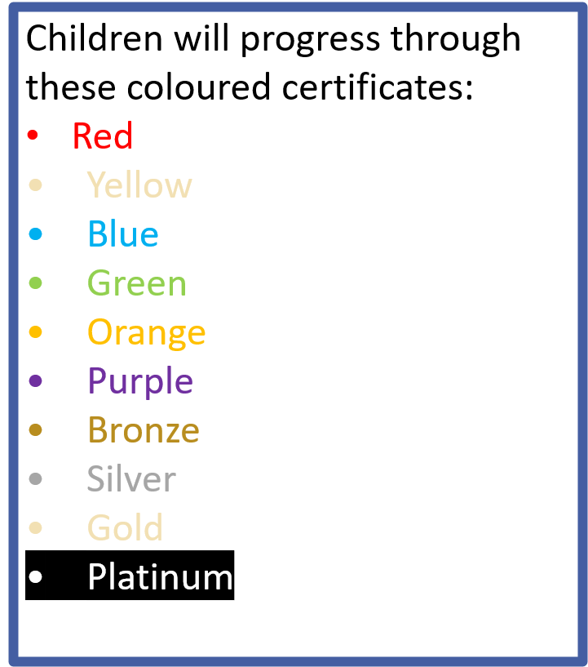
Values River
In each class the values river is displayed and everyone has their name on the river.​
Your name badge will be moved around the river when you show our school values and are being ‘values ambassadors’.
Every time they reach the starting point they will receive a dot on the class chart, when they receive 3 dots they receive a coloured values certificate in an assembly.

Slide 7
Year 5 Expectations as part of our behaviour curriculum
Develop confidence, resilience and independence ​
Encouraging the children to:​
Be responsible for their belongings ​
Bringing in reading book and book bag
Taking care of the environment​
Kind and considerate to others
‘Have a go attitude’ to learning challenges

Slide 8
Class Timetable
This is a rough outline of our class timetable – this is subject to change but gives an idea of how the week is planned:
Mon, Tues, Thurs, Friday AM
Weds AM
Handwriting | Spelling | English | Reading | Maths
French | English | Reading | Maths

Slide 9
Class Timetable
This is a rough outline of our class timetable – this is subject to change but gives an idea of how the week is planned:
PM
Monday | Tuesday | Wednesday | Thursday | Friday
PE | RE | Science | PE | DT/Art
Music | PSHE |  | History/ Geography

Slide 10
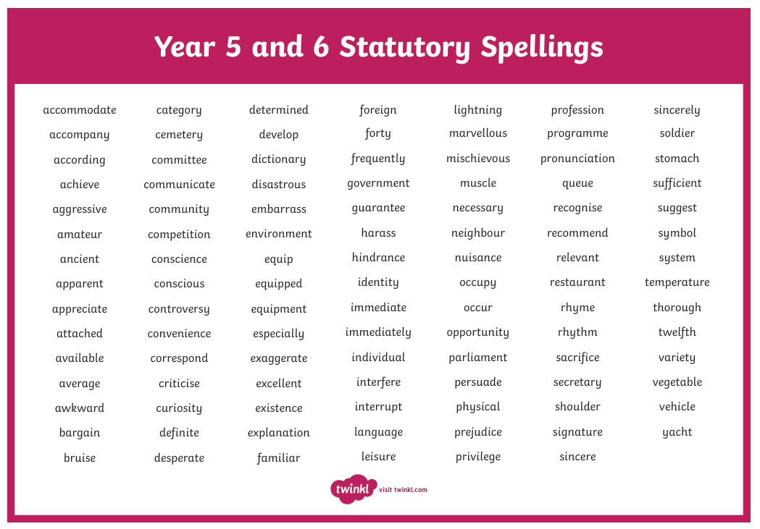
Spelling
Spelling is taught in school but any support with spelling is greatly received. Here are the Common Exception Words (the words that are trickier and don't follow a spelling pattern) for each year group. These are great words to practise at home. There will be links to these on the class pages on the school website.

Slide 11
Times tables
As school we subscribe to TTS and everyone in KS2 has a login.
We are also looking to roll out Numbots for younger children.
For children in Years 3 and 4 this website is great for practising for the times table test at the end of year 4.
Multiplication Tables Check - 2026 - Timestables.co.uk

Slide 12

Phonics and Reading
Our reading sessions will have a strong focus on whole-class reading, developing both children’s fluency and comprehension skills.
We will explore a range of engaging texts together, helping children to read with increasing accuracy, expression and understanding.
Activities and questioning will be carefully adapted so that every child can access the text while also being appropriately challenged.
Children will receive additional modelling, vocabulary support and opportunities to practise where needed, while deeper questioning and more complex tasks will encourage confident readers to extend their thinking and justify their ideas using evidence from the text.

Slide 13
Our class information
PE days are: Monday and Thursday
Reading books changed: Thursday
Water bottles: Please provide a named water bottle for you child. These will be sent home each day.
Art shirts: Please provide your child with an old t-shirt for art. This needs to be big enough to go over their own clothes.

Slide 14

Interventions
We run several interventions in school to support your child with their learning.
These include:
Handwriting​
Self-esteem​ groups using ‘Think Good, Feel Good’ resources
Number work​
Regular reading​
Little Wandle Catch up Phonics​
If your child has a SEN pupil passport, these will be detailed on this.

Slide 15
Helping your child at home
Reading:5 x weekly, signed in book​
Spellings: Practice statutory spellings at home
Practise phonics if needed
Times tables/Number Bots: School subscriptions, logins provided
You play a crucial role in helping your children learn. Children achieve more when schools and parents work together in partnership.

Slide 16

Visits
As part of our curriculum offer, we like to take children on a variety of trips to enhance our curriculum and offer different learning experiences.
You will receive a letter after half term outlining the trip costs for the year and on Parent Pay payment instalments will be set up to help.
Obviously, there are some opportunities and visits that occur after this initial letter, but we try to keep these to a minimum.
The visits planned this year are:
We the curious
Greek workshop
One local area visit – field work (TBC)

Slide 17
Arbor
All communication is sent via Arbor so it is essential you can log on to your Arbor account.
You can download an app, so you don't have to use a web browser all the time.
The following is booked through Arbor
Lunches (this needs to be booked a day before)
Tuck cards
Breakfast club
Visits
Parents' Evening
Whole School Events
If you cannot access Arbor, please speak to the office.

Slide 18
Volunteers / Visitors
We love having visitors and volunteers in school so if you have a special skill you can share then please speak to us.
We also have several volunteers who visit regularly.
These volunteers have a DBS check as part of our safeguarding policy which can be carried out and is a simple online form that the office can set people up with.
If you can, we would love to have many more volunteers ☺

Slide 19

Any Questions?
Do you have any questions for us?

