Slide 1

St Nicholas Church School
Welcome Meeting
Cam Class
Friday

Slide 2

Meet the team
Our class team this year:
Mrs Warde Mrs Kirkwood (Weds)
Mrs Harris Mrs Clifford

Slide 3

School Values
Throughout our learning and school day, we will be focus on our 6 core values of:
Koinonia
Compassion
Hope
Forgiveness
Trust
Endurance

Slide 4
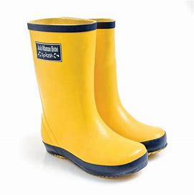


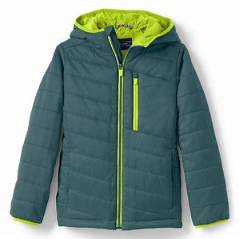
Year R Expectations
Develop confidence, resilience and independence ​
Encouraging the children to:​
Be responsible for their belongings ​
Bringing in reading book and book bag
Coming into school as independently as possible
Taking care of the environment​
Be kind and considerate to others
‘Have a go’ and to learn new challenges

Slide 5

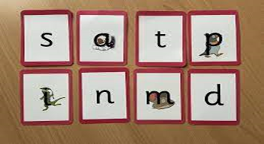
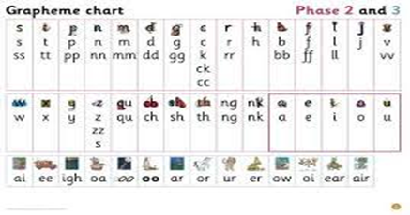
Phonics and Reading in EYFS
Our phonics scheme is called ‘Little Wandles’
Children begin by learning a phoneme (the sound) and the corresponding grapheme (the letter).
We will be using this terminology and language.
Each phoneme/grapheme is represented by an image and a phrase to embed learning. There is also a formation phrase to help the children to write the letter.
Children are encouraged to hear the first sound in a word so we use collections of pictures and objects that all begin with the same sound, a bit like the game of I-spy.

Slide 6
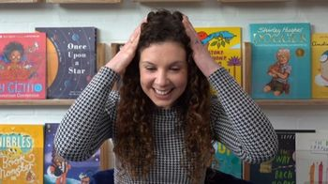
Phonics and Reading in EYFS
Oral Blending
Children play games to encourage them to hear sounds and blend them together, for e.g touch your h-ea-d t-oe-s m-ou-th kn-ee-s.
Guessing what picture is hiding when an adult ‘sound talks’ for them. S-u-n p-e-g s-o-ck
Other games include: Can you do the actions?
And What’s that noise?

Slide 7
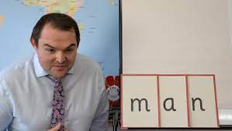
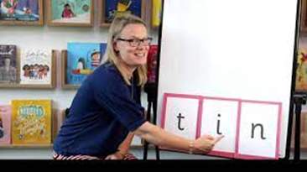

Phonics and Reading in EYFS
Children will use their skills of blending to begin ‘sounding out’ and reading whole words.
They will need to recognise the graphemes/phonemes ‘Sound them out’ and then blend them together.
Once they have secured this skill they will bring a fully decodable book home with them. They will have the same book all week
They will also be reading this book at school 3 times a week and practising different skills such as reading with expression and showing an understanding of the story as well as using their phonic skills.
They may also bring home a sharing book that will be for pleasure and enjoyment.

Slide 8
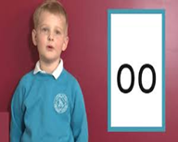

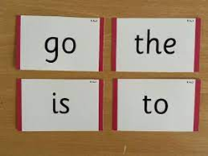
Phonics and Reading in EYFS
Digraphs/trigraphs
These are taught in exactly the same way with a memorable phrase.
The key vocabulary that the children will learn is :2 letters one sound/3 letters 1 sound.
Tricky words
Children will also learn some simple tricky words alongside their sounds.
Words that are difficult to ‘sound out’ are often referred to in class as ‘tricky’ words. The children will learn to recognise these and also ’sound out’ the parts that they can. For e.g is and go

Slide 9
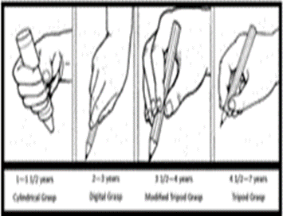
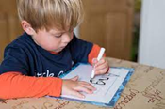

Writing
The most important way that you can support your child is by strengthening both their small (fine motor) and large (gross motor) muscle control.
Examples of activities that help with fine motor skills are threading, cutting with scissors, play dough and small scale construction.
Climbing, painting at an easel and wind ribbons can help to strengthen the shoulder which will help with pencil grip.
Any mark making tools should be encouraged, e.g. sticks in the mud, chubby chalks, paintbrushes, crayons and pencils.
Correct pencil grip is vital as children progress in their schooling as they have better stamina and find joining easier.

Slide 10
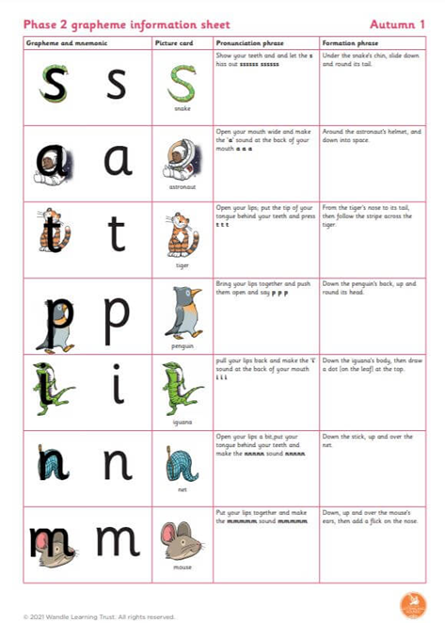
Writing
Practise the letter formation that we are using in school, saying the phrase to remember it.
Writing is a complex process, involving physical skills, hearing the sounds and finding the correct grapheme/letter to match
Encourage this skill by asking what sounds can be heard in words, for e.g n-u-t, t-i-n, c-a-t
Practise name writing regularly and remember to use lower case letters

Slide 11
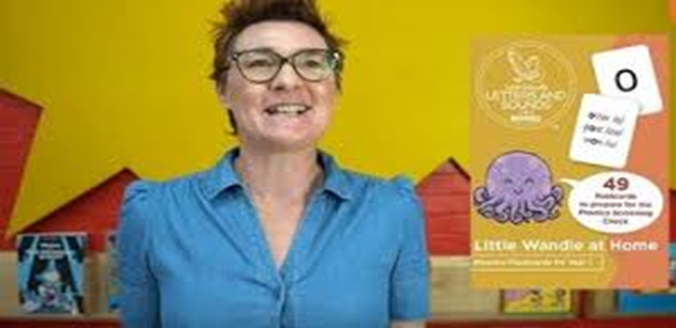
Support for parents and carers
You can find out lots of information by visiting the Little Wandle Website
There are videos that you can watch for guidance and documents that you can download to help with pronunciation and formation
https://www.littlewandlelettersandsounds.org.uk/resources/for-parents/

Slide 12
Our class information
PE days are: Wednesdays
Reading books changed: 1 X weekly
Water bottles: Please provide a named water bottle for you child. These will be sent home each day

Slide 13

Interventions
We run several interventions in school to support your child with their learning.
These include:
Physical skills/Handwriting​
Self-esteem​ groups using ‘Think Good, Feel Good’ resources
RAPID maths, RAPID reading, RAPID writing​
Number work​
Regular reading​
Little Wandle Catch up Phonics​
Gym trail with Write Start
If your child has a SEN pupil passport, these will be detailed on this.

Slide 14
Helping your child at home
Reading:5 x weekly, signed in book​
Physical/Writing skills
Practise phonics (use sheets sent home as a guide)
Expand vocabulary by talking and listening, encourage using full sentences
You play a crucial role in helping your children learn. Children achieve more when schools and parents work together in partnership.

Slide 15

Visits
As part of our curriculum offer, we like to take children on a variety of trips to enhance our curriculum and offer different learning experiences.
You will receive a letter by half term outlining the trip costs for the year and on Parent Pay payment instalments will be set up to help.
Obviously, there are some opportunities and visits that occur after this initial letter, but we try to keep these to a minimum.
The visits planned this year are: Carymoor Environmental Centre and Bristol Aquarium.

Slide 16

E-Schools
Parent Platform
We have an online platform which is called e-schools which most parents use.
We use this for:
Newsletters
Individual communication of documents as necessary
Booking parents evening
The best way to access this is through the e-schools apps which are free to download – see next slides.
If you cannot access e-school, please speak to the office.

Slide 17

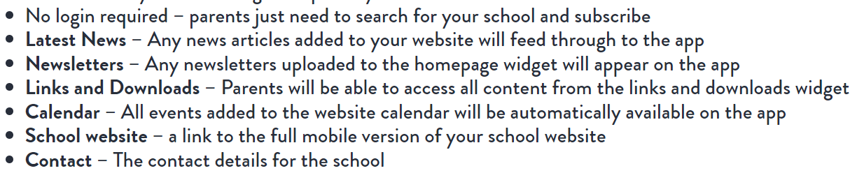
Our website is currently being updated but this app will allow you to have a live feed of any changes to the school website including:
If you cannot access e-school, please speak to the office.

Slide 18

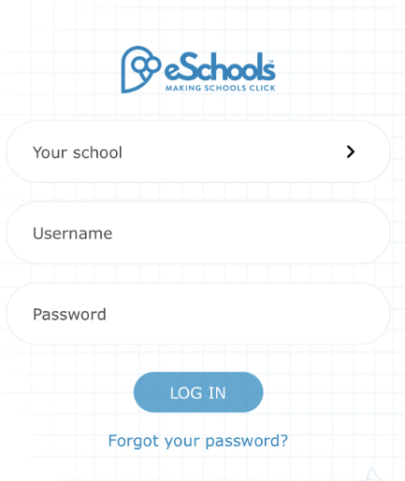

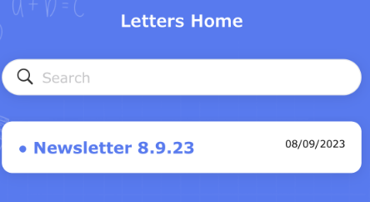
Download the App
Search School: St Nicholas Church School
Login using the same username and password as the website login.
You can then access the following information

Slide 19
Volunteers / Visitors
We love having visitors and volunteers in school so if you have a special skill you can share then please speak to us.
We also have several volunteers who visit regularly.
These volunteers have a DBS check as part of our safeguarding policy which can be carried out and is a simple online form that the office can set people up with.
If you can, we would love to have many more volunteers ☺

Slide 20

Any Questions?
Do you have any questions for us?

