Slide 1
St Nicholas Church School
Welcome Meeting
Wellow Class
Friday

Slide 2
Meet the Wellow Team
Our class team this year:
Miss. Parrott Mrs. Lamb
Mrs. Wilkinson Mrs. Turner

Slide 3
School Values
Throughout our learning and school day, we will focus on our 6 core values of:
Koinonia
Compassion
Hope
Forgiveness
Trust
Endurance

Slide 4
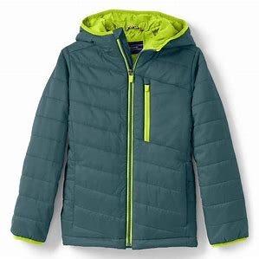
Wellow Expectations
Develop confidence, resilience and independence ​
Encouraging the children to:​
Be responsible for their belongings ​
Taking care of the environment​
Kind and considerate to others
‘Have a go attitude’ to learning challenges
Wait their turn when others are talking

Slide 5
Phonics and Reading in KS1
We will aim to read with your child 2 to 3 times each week. Your child will also be involved in whole class reading activities as well as small group activities. Please read with your child a couple of times each week at home.
Please could you send a book bag in with your child each day as this helps when they take books/ letters etc home.
We started using the 'Little Wandle' Phonics scheme last year. The children are spilt into three differentiated groups so we can tailor the teaching to suit their specific needs. They have a phonic session each morning.

Slide 6
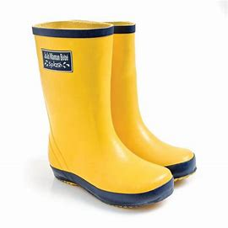
Our class information
PE day is: Monday. Please send a P.E kit in on Monday morning and we will return it on Friday afternoon for washing.
Each child has a sounds folder: Please bring back every day in the book bag.
Reading books changed: Reading books are kept for at least a week to develop fluency and confidence.
Wellies: We regularly use the Forest Area within the school grounds. Please can you provide a pair of wellies for the children to change into.
Water bottles: Please provide a named water bottle for your child. These will be sent home at the end of each week.

Slide 7
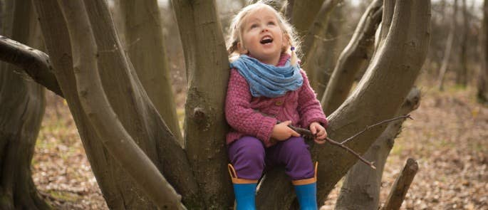
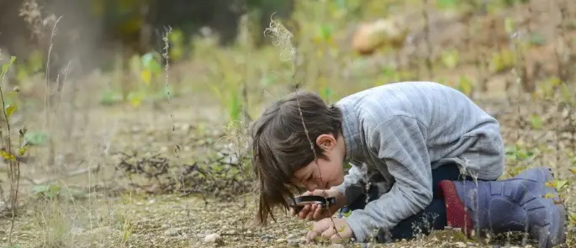
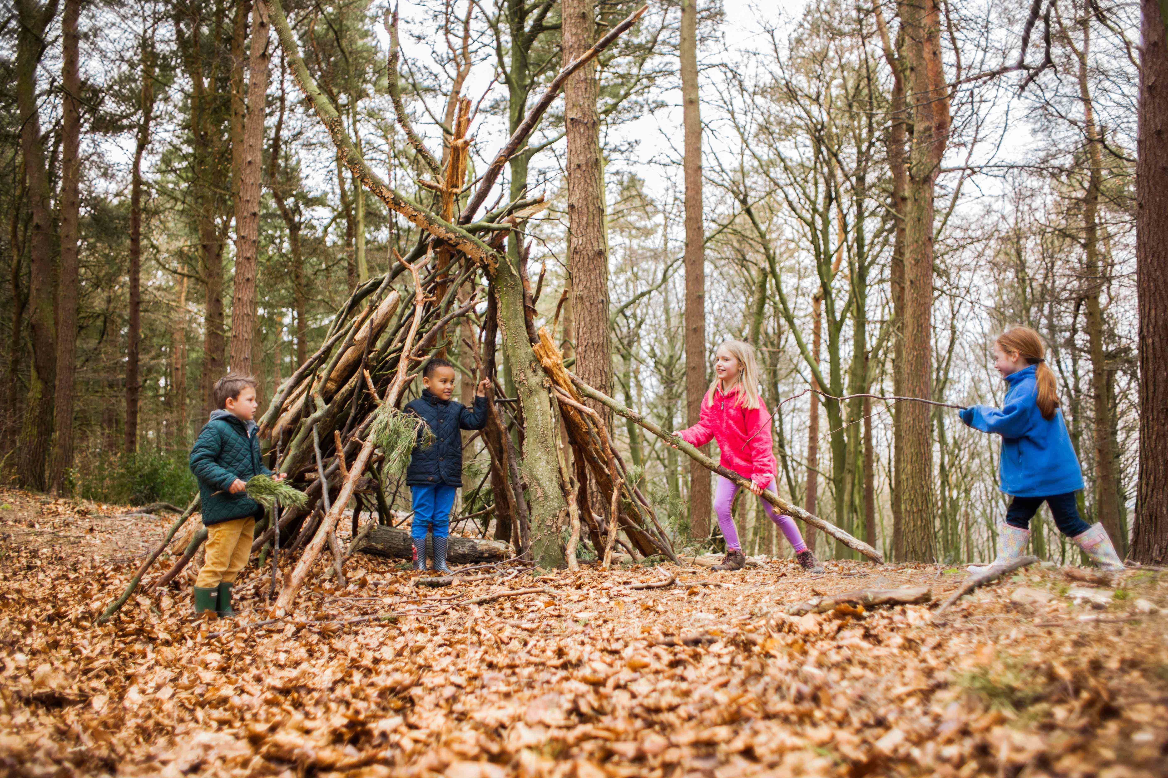
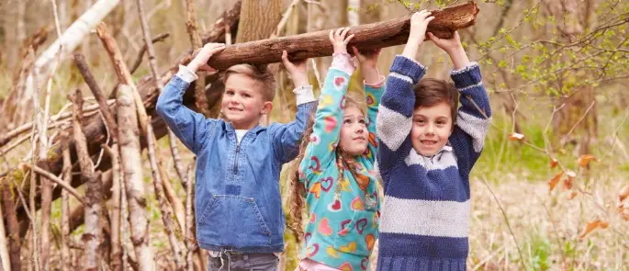
Forest School
Children in Wellow Class regularly have access to the forest area within the school grounds. We have found children benefit enormously from time spent in the natural world.
Forest School sessions can:
Develop greater curiosity of the world around them.
increase a child's self-esteem through exploration.
Build resilience.
Provide opportunities for problem solving and risk taking.
Enable children to work co-operatively.
Encourage communication and develop language.
Increase motivation and concentration.
Improved overall well-being and mental health.

Slide 8
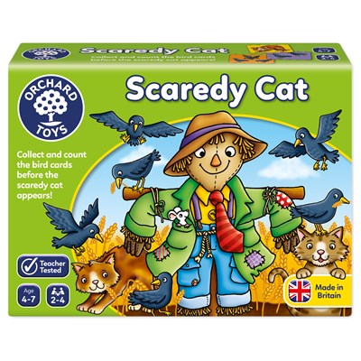
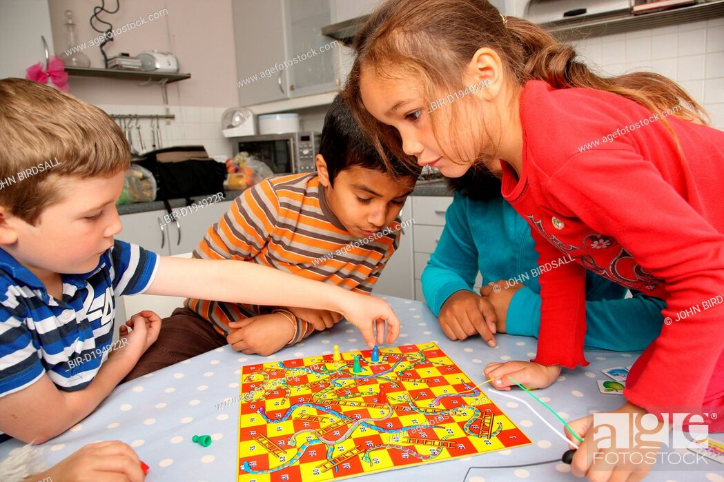
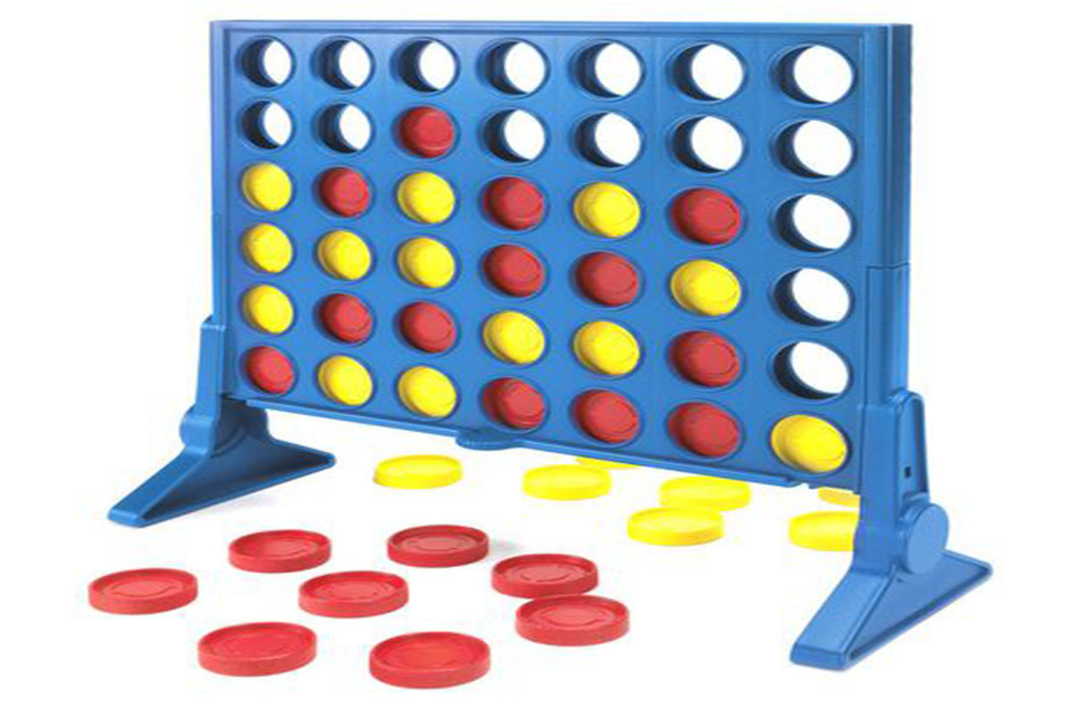
Playing games
In Wellow Class we often spend time playing games such as, Snakes and Ladders, Frustration, Connect 4, Happy Families, Snap, Pairs, Scaredy Cat as this helps children to develop skills of:
Turn taking.
Co-operation.
Waiting their turn.
Boosting self-esteem and teaching them how to win and lose gracefully.
Speech and Language.
Following instruction.
Mathematics.

Slide 9
E-Schools Parent Platform
We have an online platform which is called e-schools which most parents use.
We use this for:
Newsletters
Individual communication of documents as necessary
Booking parents evening
The best way to access this is through the e-schools apps which are free to download – see next slides.
If you cannot access e-school, please speak to the office.

Slide 10
Our website is currently being updated but this app will allow you to have a live feed of any changes to the school website including:
If you cannot access e-school, please speak to the office.

Slide 11
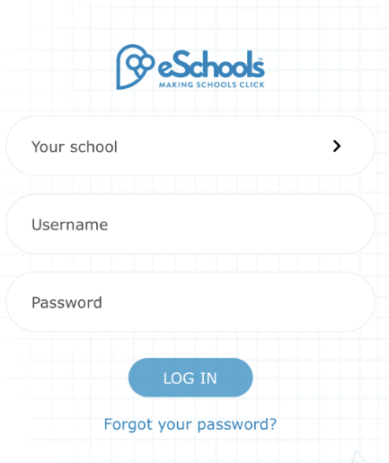
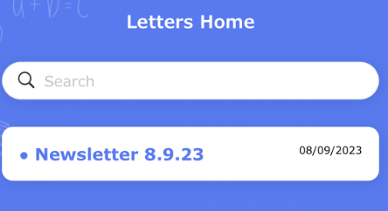
Download the App
Search School: St Nicholas Church School
Login using the same username and password as the website login.
You can then access the following information

Slide 12
Volunteers / Visitors
We love having visitors and volunteers in school so if you have a special skill you can share then please speak to us.
We also have several volunteers who visit regularly.
These volunteers have a DBS check as part of our safeguarding policy which can be carried out and is a simple online form that the office can set people up with.
If you can, we would love to have many more volunteers ☺

Slide 13
Any Questions?
Do you have any questions for us?

