Slide 1
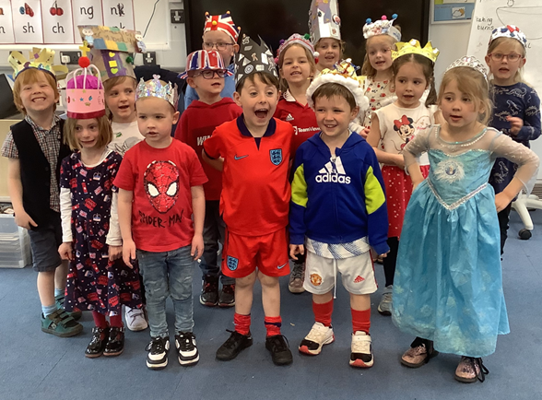
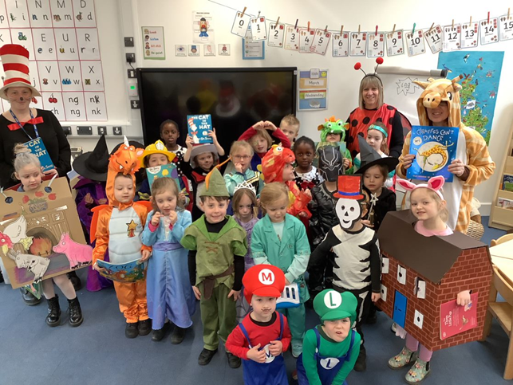
Welcome to St Nicholas Church School
On behalf of everyone here at St Nicholas we would like to welcome your family to our school community and to a brand new and exciting chapter in your child’s life.

Slide 2
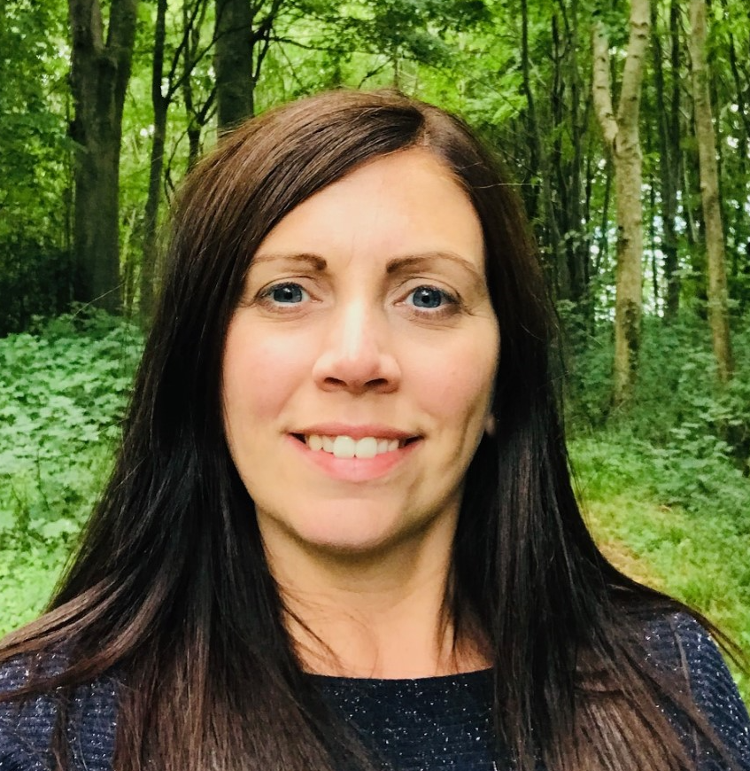
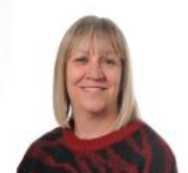
Staff at St Nicholas
Co-Heads of School:
Mrs Kirsty Biss, Mr Will Low
SENCo: Mrs Helen Crossen
Executive Head: Mr Joe Beament
EYFS Lead and Class Teacher:
Mrs Lisa Warde
Teaching Assistant and HLTA:
Mrs Krystie Kirkwood

Slide 3
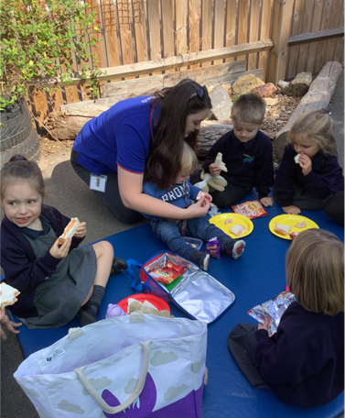
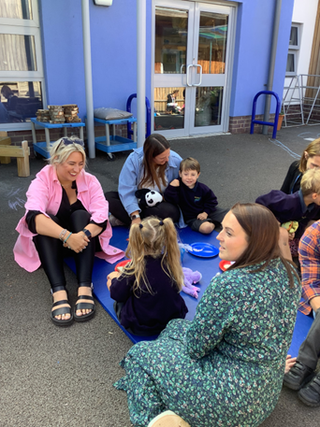
Starting School
During their reception year your child will have lots of opportunities to meet new people and make new friends.
They will also learn basic social and academic skills that will be the foundation for life-long learning.
We believe that you are the experts in your children and value and welcome working in partnership with you.

Slide 4
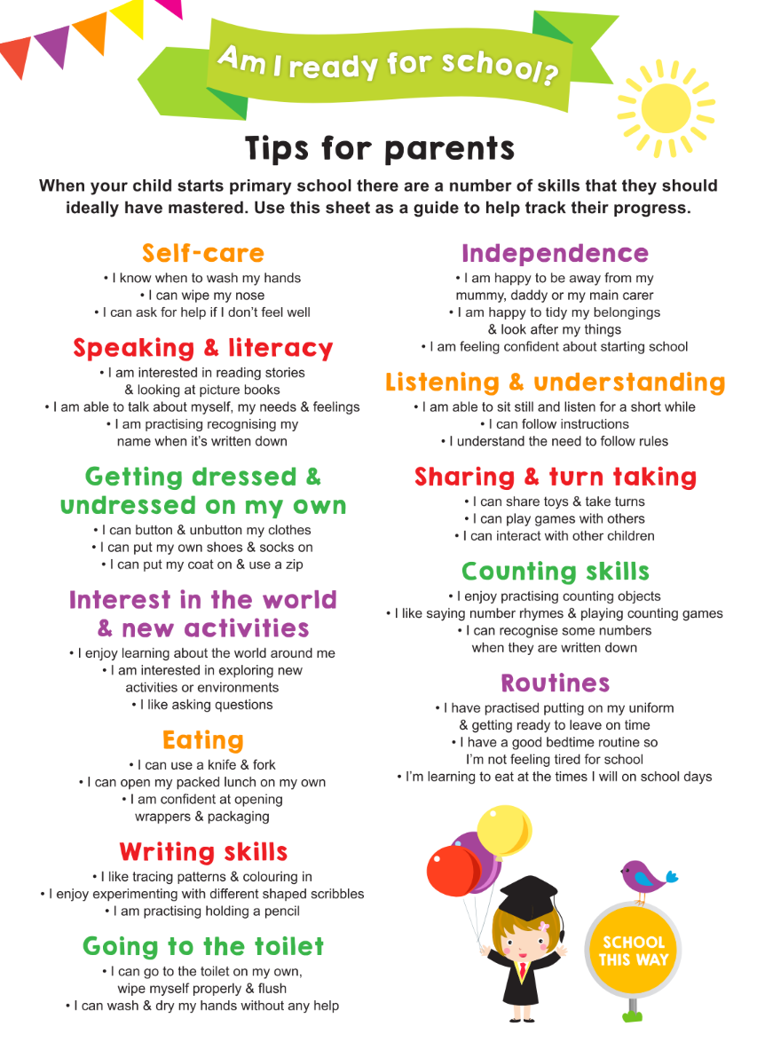
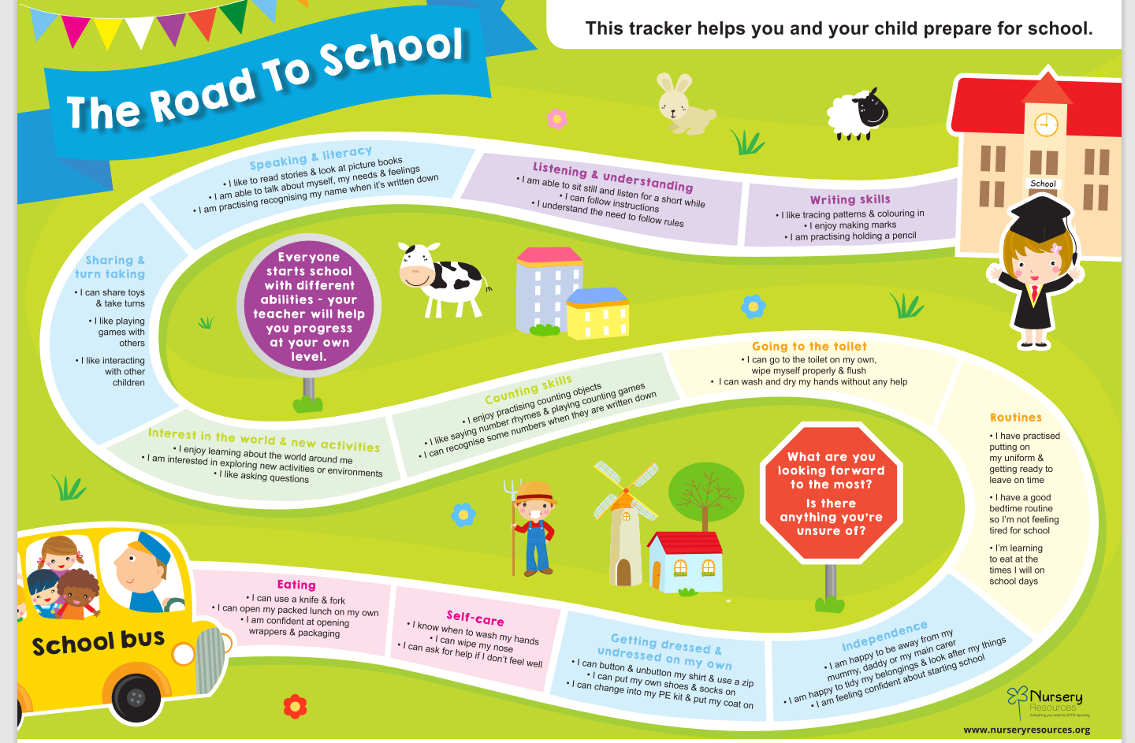
Is my child ready for school?
We would encourage you to look at the leaflet ‘The Road To School’ which can be used as a general guide to some of the expectations at school entry. If your child attends a childcare setting, they will also be focusing on some of these skills too.
Please don’t worry! We realise that all children will have different strengths and that they may be working on some skills a little longer than others.
If you are concerned about any aspect of your child’s development or their readiness for school, then you can arrange to speak to one of the team. We can also discuss any questions during your home visit.
There are also some useful websites that you may wish to take a look at:
Being school-ready | PACEY
School readiness: How to prepare your child for school - BBC Tiny Happy People
☺

Slide 5
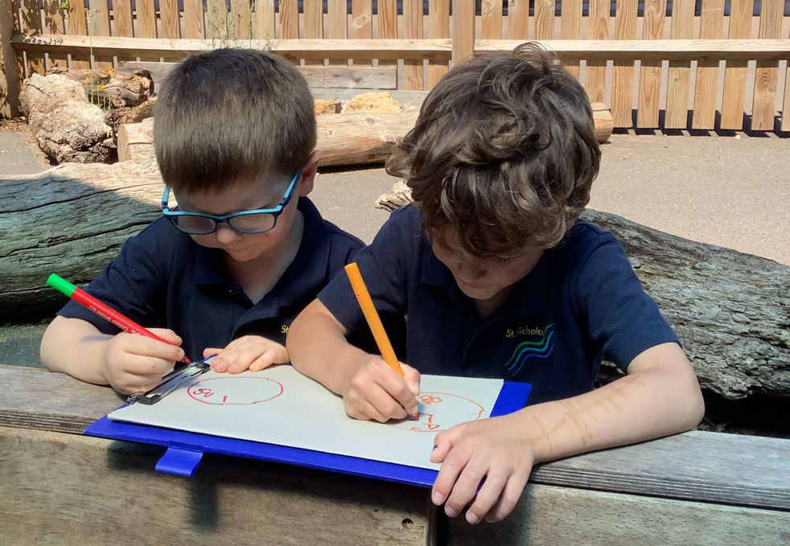
Top Tips for Starting School
Labels
Please permanently label everything that can be taken off!
Drop Off
Promote a positive drop off and try not to prolong your goodbyes if your child is upset. Familiar staff will quickly respond to and comfort your child. They usually settle before you have left the school grounds. You may find that your child might have a regression in their confidence to separate from you. Please be reassured that this is completely normal and will pass.
Shoes
Provide school shoes that your child can independently take on and off to foster their independence.
Clothes
Please provide a bag of spare clothes to be kept on your child’s peg in case of accidents and replenish if they are used in school.
Toys
Please try and discourage your children from bringing in toys from home. It’s often upsetting when they have to be left at the school gate. We may sometimes ask for show and tell items that are linked to our topic and we will also try to share important achievements from home such as sports certificates. These can also be shared in our Celebration assemblies that take place fortnightly on a Friday.
We are able to offer some flexibility in your child’s settling period should you feel that they require it ☺

Slide 6
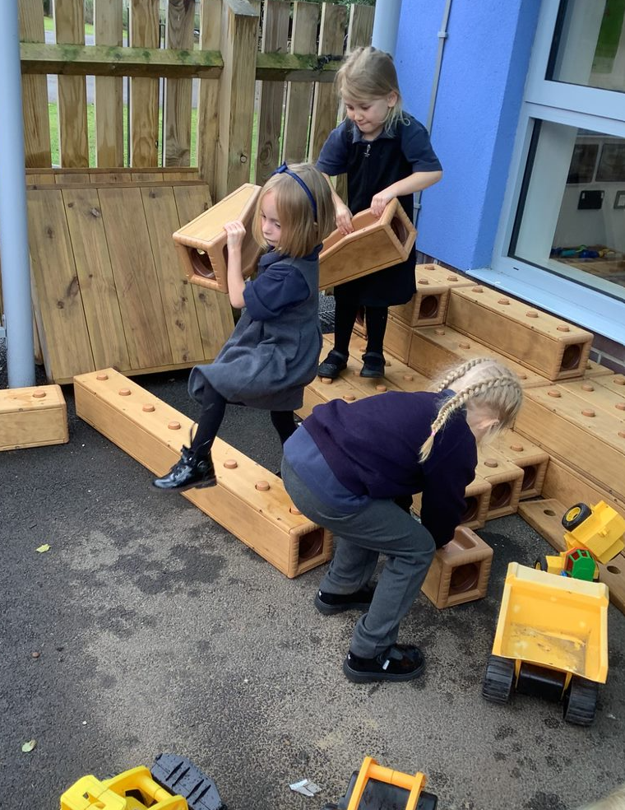
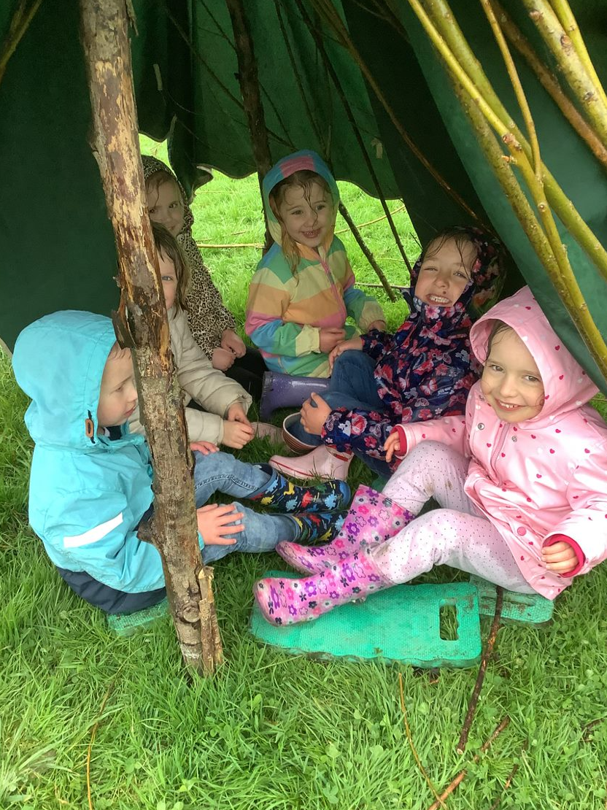
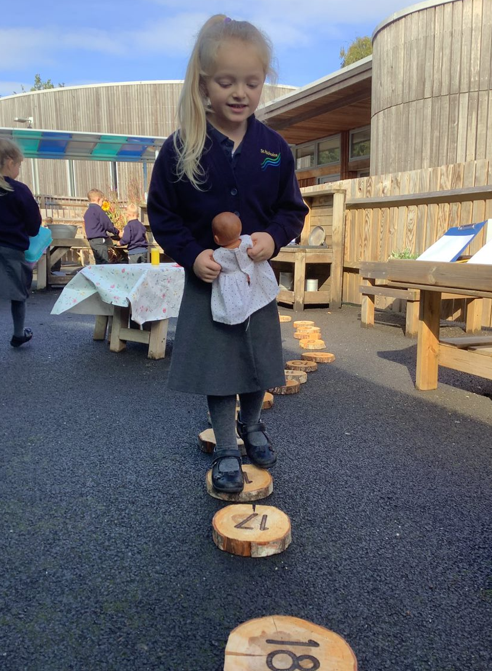
Any questions?

