Slide 1
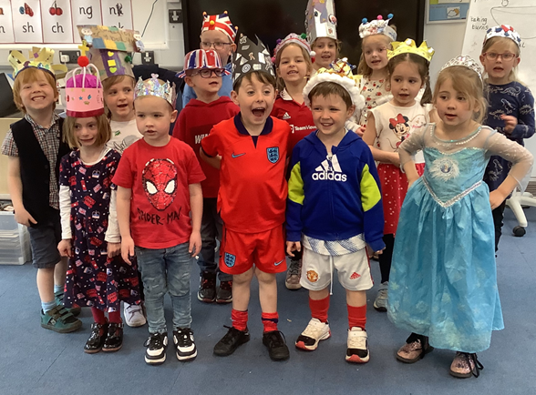
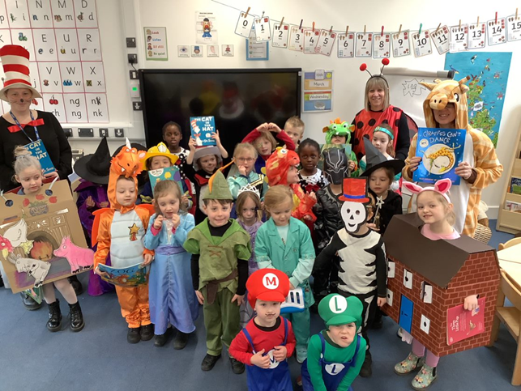
Welcome to St Nicholas Church School
On behalf of everyone here at St Nicholas we would like to welcome your family to our school community and to a brand new and exciting chapter in your child’s life.

Slide 2
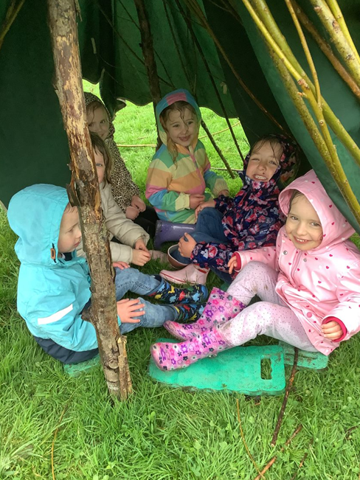
EYFS: Early Years Foundation Stage
What will we be learning and how will we learn it?
There are 7 areas which are referred to as either Prime or Specific.
Prime areas: Communication and Language, Personal, Social and Emotional development and Physical development.
Specific Areas: Literacy, Mathematics, Understanding the World and Expressive Arts and Design
The Early Years Foundation Stage curriculum promotes the importance of children learning and developing through play.
During the day, the children take part in daily adult-led focus sessions and independent child-led activities as they access the continuous provision.

Slide 3
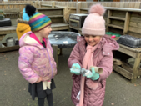
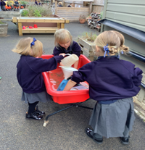
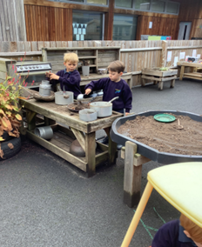
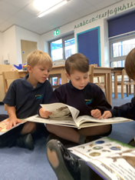
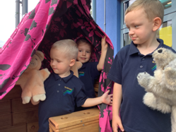
Communication and Language ‘The Golden Thread’
Listening, attention and understanding
Speaking
Children will be exposed to a rich language environment where adults will model, scaffold and extend vocabulary.
Children will develop their understanding, learn how to ask and answer questions and become more confident to express their ideas, thoughts and feelings.
They will explore language in a variety of ways, including stories, role play, songs and rhymes. They will learn what makes a good speaker and an effective listener. Children will work with adults, in partnerships and in small groups to enhance their language skills.

Slide 4
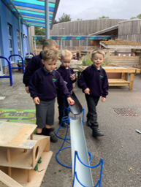
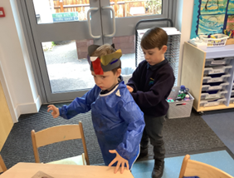
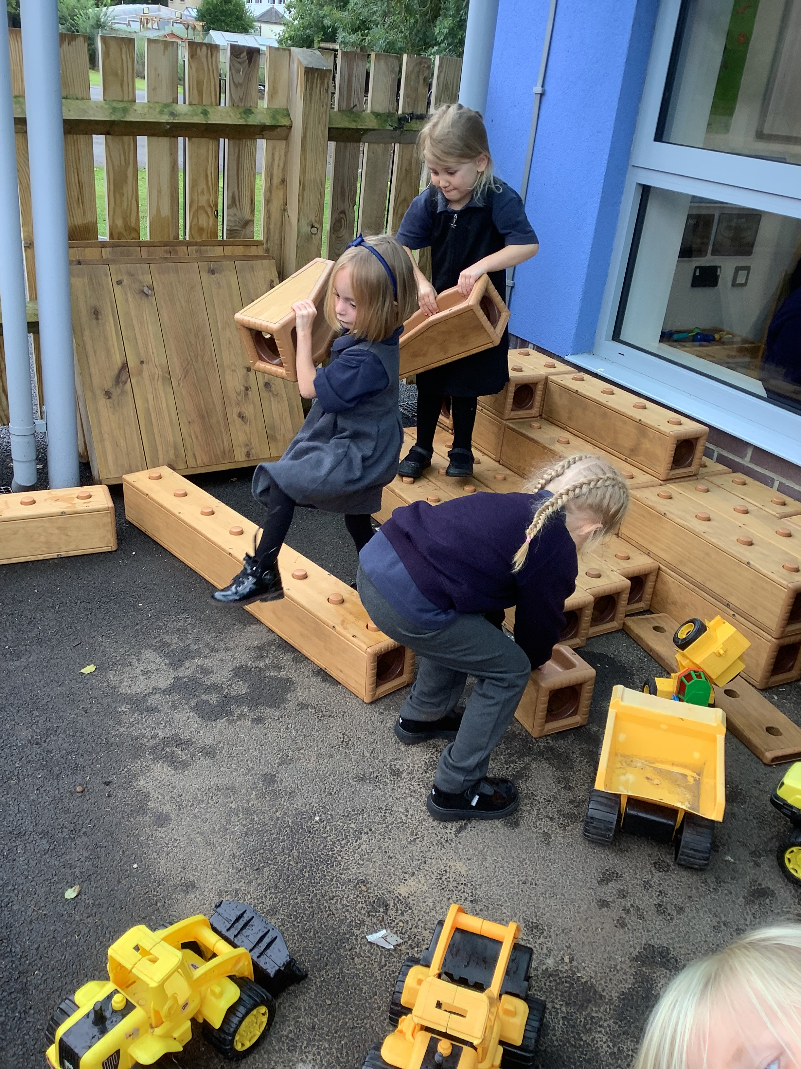
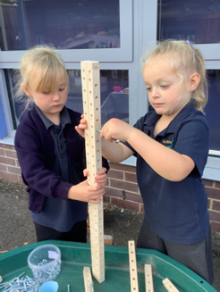
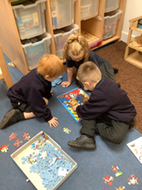
Personal, Social and Emotional Development Self regulation Managing self Building relationships
Through play children will learn how to cooperate, negotiate and make compromises.
They will build relationships with adults and peers and learn how to sustain friendships.
Children will develop resilience and perseverance skills.
Children will learn to identify a range of feelings and how to manage them appropriately.
They will learn how to manage personal hygiene routines and the importance of healthy food choices.

Slide 5
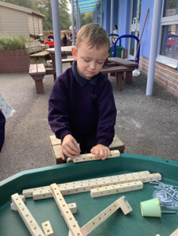
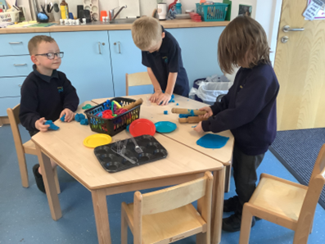
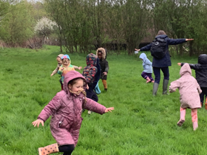
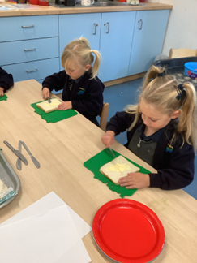
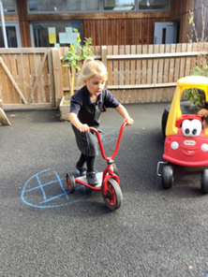
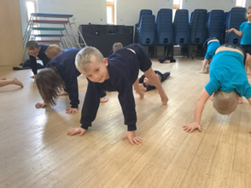
Physical Development
Fine motor skill
Gross motor skills
Fine Motor Skills
Children will use a range of tools, including scissors, crayons, paintbrushes and pencils.
Using small scale equipment helps to strengthen finger control in preparation for writing.
Gross Motor skills
They will learn to negotiate space and obstacles safely.
They will develop their coordination, strength and balance and experiment with moving in a variety of ways.

Slide 6
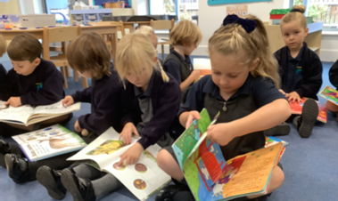
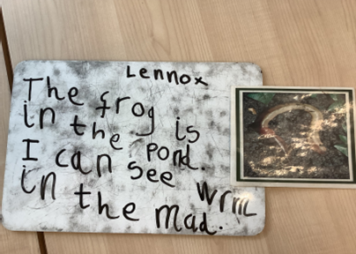
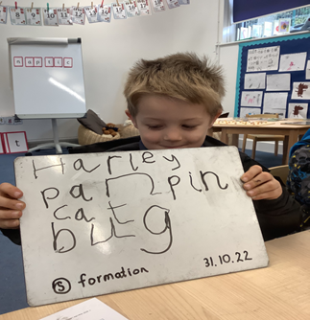
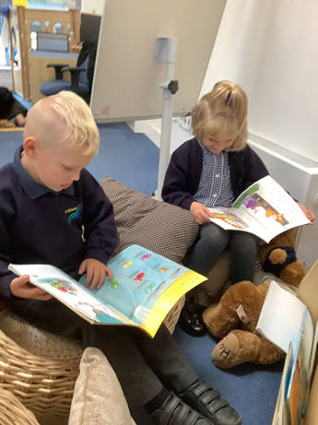
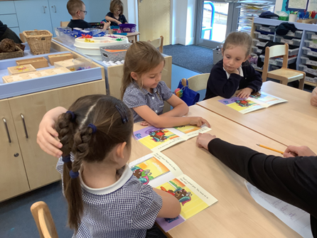
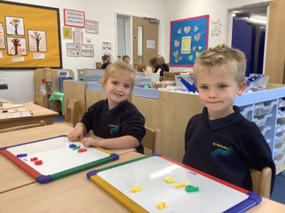
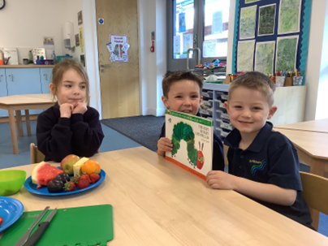
Literacy Comprehension Word reading Writing
Reading
Children learn letter names and sounds.
They begin to read words by ‘sound blending’ and answer questions about what they have read to demonstrate their understanding.
Writing
Children learn how to form letters correctly. They write simple words by using their growing sound awareness.
They will work towards writing simple phrases and sentences.

Slide 7
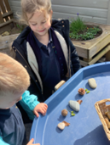
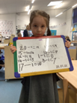
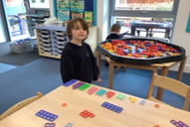
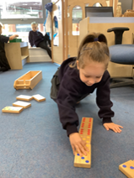
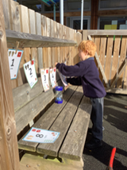
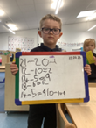
Mathematics
Number
Numerical patterns
Through play children develop their mathematical language and investigate and solve problems.
They will learn to count accurately to 20 and beyond. They will also practise recognising smaller amounts like dice dots without needing to count.
They will learn to use numbers in play with purpose.
They will also use their number knowledge to understand simple calculations.

Slide 8
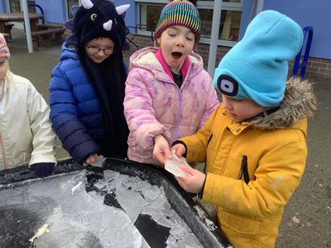
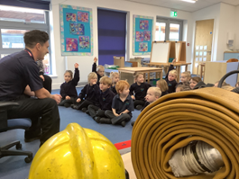
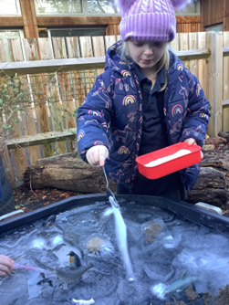
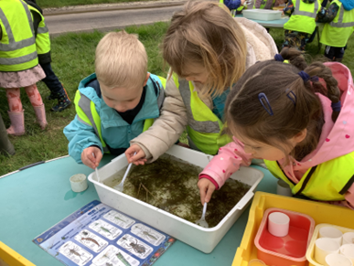
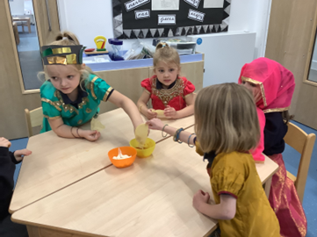
Understanding of the World
Past and present
People, culture and communities
The natural world
Children will begin to develop an understanding of past and present.
They will explore similarities and differences in the context of religious and cultural communities and ways of life in other countries.
Children will learn about the natural world and how things change around them.
They will explore their environment and use their observations to make simple predictions.

Slide 9
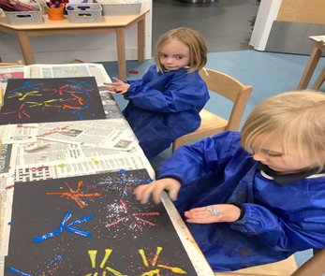
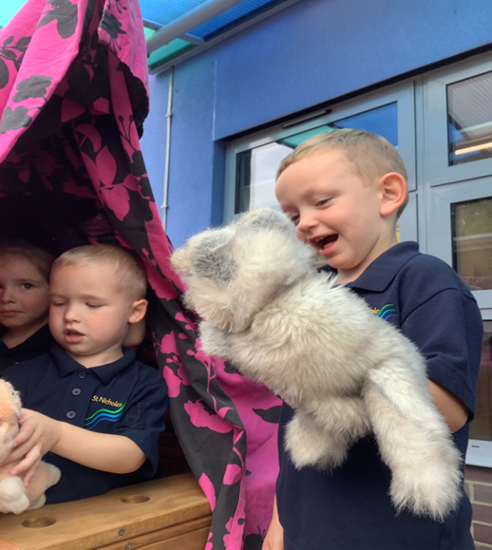
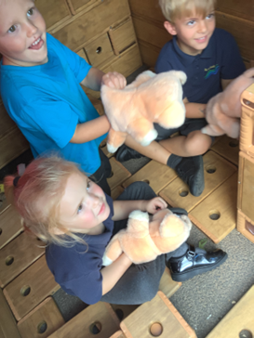
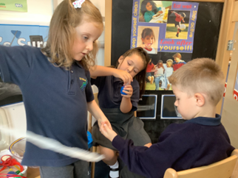
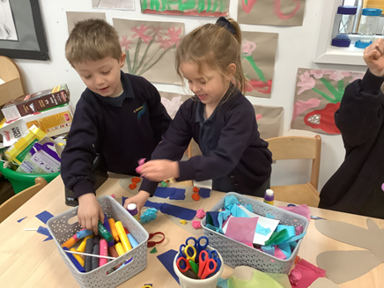
Expressive Arts and Design
Creating with materials
Being imaginative and expressive
Through play children will explore a variety of materials and tools and talk about what they create.
They will experiment with design, role play and music and make use of props when engaged in narratives and stories

Slide 10
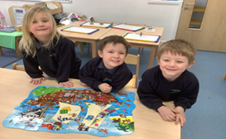
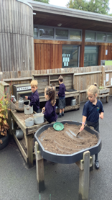
A Typical Day in Reception
8:35: Gate Opens we welcome the children into the school. The children come in and sit on the carpet with the TA. They look at a book or practise their letters.
8.45: Register
9:00: Collective worship
9:20 Phonics input on the carpet. This is followed by adult led activities which have a literacy focus. This is supported by a range of enhancements in continuous provision. An adult provides scaffolding in the environment to extend the children’s learning.
10:40: Tidy up, Snack time and Numberblocks
11:00: Maths input on the carpet. This is followed by adult led Maths activities and supported enhanced provision. At certain times in the week the children will also have P.E and a Jigsaw PSHE session
12:00: Lunch
1:00: Register
1.10: Carpet learning based on our topic of the term. Wider curriculum opportunities which include planned, adult led topic activities and continuous provision activities to enhance play and development.
3.10: Story and preparation for home
3:30 Home Time
Home time is 3.30pm Monday – Thursday
Home time is 3.00pm Friday
Home time is 1.00pm on the last day of term at Christmas, Easter, Summer.

Slide 11
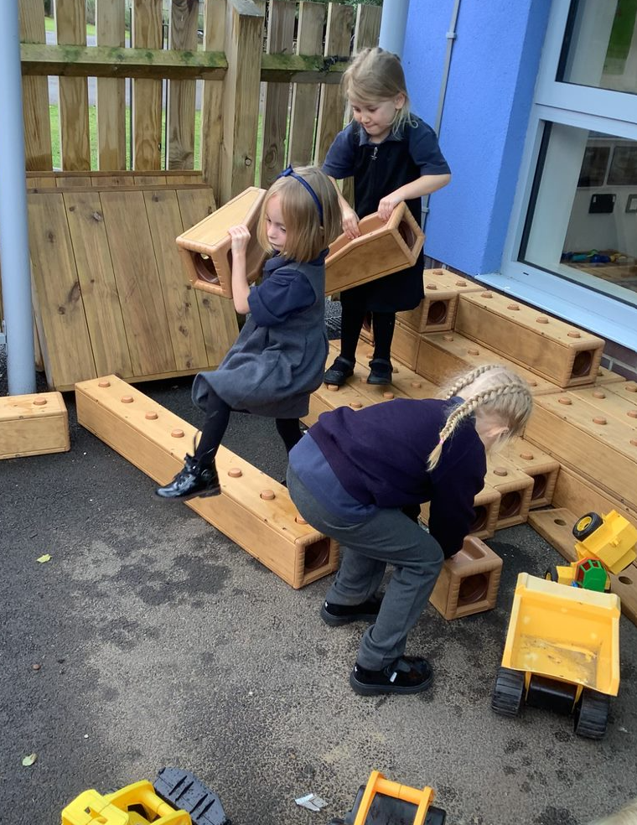
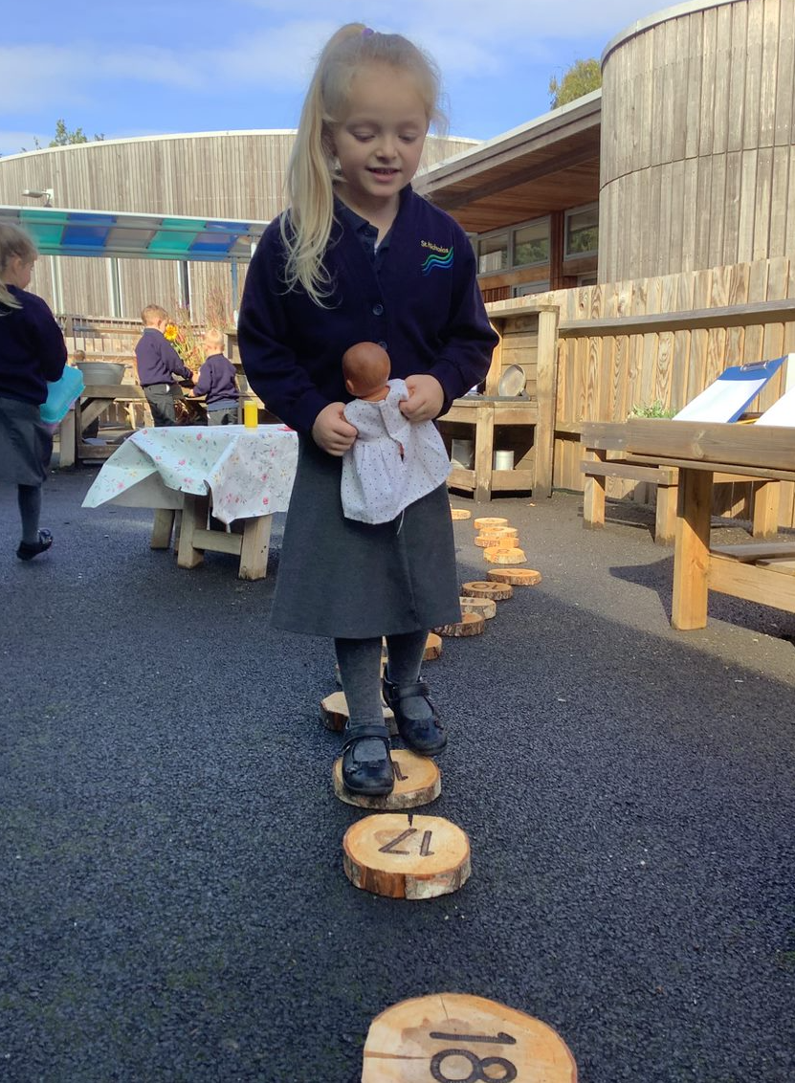
Any questions?

