Slide 1

St Nicholas Church School
Phonics and Reading Information: EYFS
Friday

Slide 2

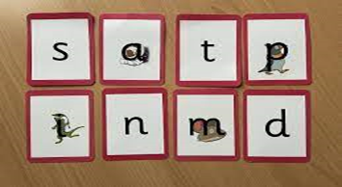
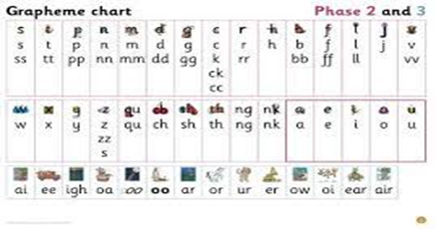
Phonics and Reading in EYFS
The phonics scheme is called ‘Little Wandle’
Children begin by learning a phoneme (the sound) and the corresponding grapheme (the letter).
We will be using this terminology and language.
Each phoneme/grapheme is represented by an image and a phrase to embed learning. There is also a formation phrase to help the children to write the letter.
As each phoneme is introduced we use collections of pictures and objects that all begin with the same sound, a bit like the game of I-spy.

Slide 3
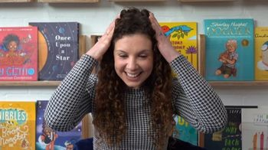
Phonics and Reading in EYFS
Oral Blending
Children play games to encourage them to hear sounds and blend them together, for e.g touch your h-ea-d t-oe-s m-ou-th kn-ee-s.
Guessing what picture is hiding when an adult ‘sound talks’ for them. S-u-n p-e-g s-o-ck
Other games include: Can you do the actions?
And What’s that noise?
Oral blending is an essential skill to master before blending with letters
And sounds.

Slide 4
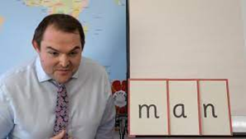
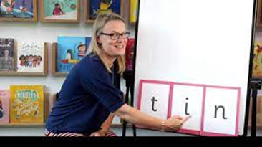
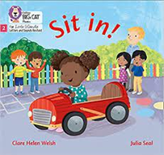
Phonics and Reading in EYFS
Children will use their skills of blending to begin ‘sounding out’ and reading whole words. This is called decoding.
They will need to recognise the graphemes/phonemes ‘Sound them out’ and then blend them together.
Once they have secured this skill they will bring a fully decodable book home with them. They will have the same book all week and read 2-3 times in a small group. During a reading session there will be a specific focus such as decoding, reading with expression or comprehension.
They may also bring home a sharing book that will be for pleasure and enjoyment.

Slide 5
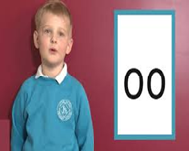

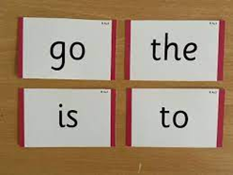
Phonics and Reading in EYFS
Digraphs/trigraphs
These are taught in exactly the same way with a memorable phrase.
The key vocabulary that the children will learn is :2 letters one sound/3 letters 1 sound.
Tricky words
Children will also learn some simple tricky words alongside their sounds.
Words that are difficult to ‘sound out’ are often referred to in class as ‘tricky’ words. The children will learn to recognise these by sight and also ’sound out’ the parts that they can.

Slide 6
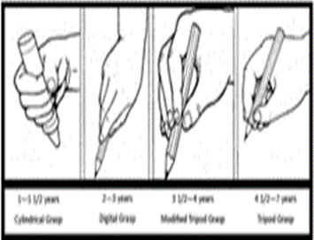
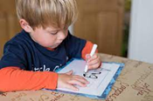

Writing
The most important way that you can support your child is by strengthening both their small (fine motor) and large (gross motor) muscle control.
Examples of activities that help with fine motor skills are threading, cutting with scissors, play dough and small scale construction.
Climbing, painting at an easel and wind ribbons can help to strengthen the shoulder which will help with pencil grip.
Any mark making tools should be encouraged, e.g. sticks in the mud, chubby chalks, paintbrushes, crayons and pencils.
Correct pencil grip is vital as children progress in their schooling as they have better stamina and find joining easier.

Slide 7
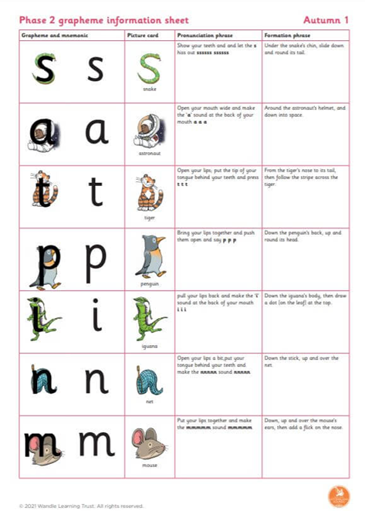
Writing
Practise the letter formation that we are using in school, saying the phrase to remember it.
Writing is a complex process, involving physical skills, hearing the sounds and finding the correct grapheme/letter to match
Encourage this skill by asking what sounds can be heard in words, for e.g n-u-t, t-i-n, c-a-t. This can be done orally before writing and children will be used to using their ‘segmenting fingers’ to help.
Practise name writing regularly and remember to use lower case letters as opposed to writing in capitals.

Slide 8
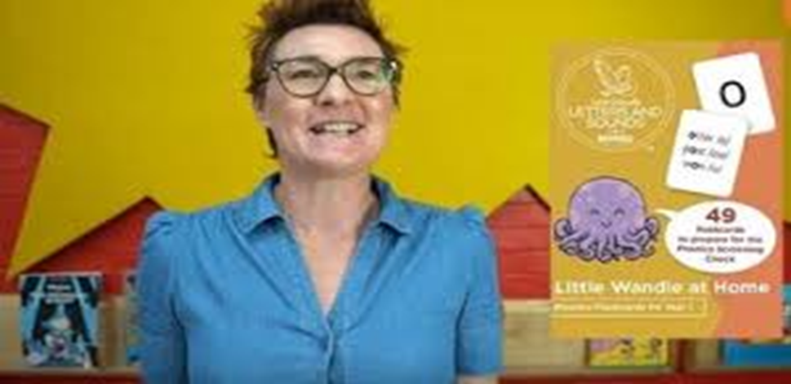
Support for parents and carers
You can find out lots of information by visiting the Little Wandle Website
There are videos that you can watch for guidance and documents that you can download to help with pronunciation and formation
https://www.littlewandlelettersandsounds.org.uk/resources/for-parents/

Slide 9

Helping your child at home
Reading:5 x weekly, signed in book​
Physical/Writing skills
Practise phonics (use sheets sent home as a guide)
Expand vocabulary by talking and listening, encourage using full sentences
You play a crucial role in helping your children learn. Children achieve more when schools and parents work together in partnership.

Slide 10
Volunteers / Visitors
We love having visitors and volunteers in school so if you have a special skill you can share then please speak to us.
We also have several volunteers who visit regularly.
These volunteers have a DBS check as part of our safeguarding policy which can be carried out and is a simple online form that the office can set people up with.
If you can, we would love to have many more volunteers ☺

Slide 11

Any Questions?
Do you have any questions for us?

