Slide 1
St Nicholas Church School
Welcome Meeting
Wellow Class
Friday

Slide 2
Meet the Wellow Team
Our class team this year:
Miss. Parrott Mrs. Mac
Mrs.Turner Mrs. Lamb Mrs. Foreman

Slide 3
School Values
Throughout our learning and school day, we will focus on our 6 core values of:
Koinonia
Compassion
Hope
Forgiveness
Trust
Endurance

Slide 4
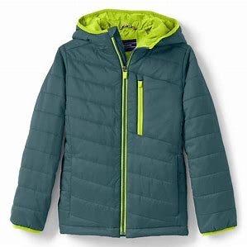
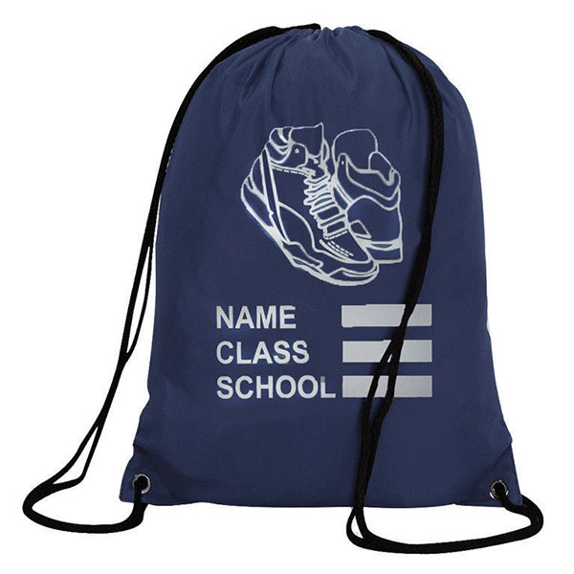
Wellow Expectations
Develop confidence, resilience and independence ​
Encouraging the children to:​
Be responsible for their belongings ​
Taking care of the environment​
Kind and considerate to others
‘Have a go attitude’ to learning challenges
Wait their turn when others are talking

Slide 5
Phonics and Reading
We will aim to read with your child 2 to 3 times each week. Your child will also be involved in whole class reading activities as well as small group activities. Please read with your child a couple of times each week at home.
Please could you send a book bag in with your child each day as this helps when they take books/ letters etc home.
We started using the 'Little Wandle' Phonics scheme across the whole school two years ago. The children are spilt into differentiated groups so we can tailor the teaching to suit their specific needs. They have a phonic session each morning.

Slide 6
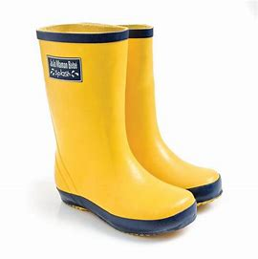
Our class information
PE day is: Monday. Please send a P.E kit in on Monday morning and we will return it on Friday afternoon for washing.
Each child has a sounds folder: Please bring back every day in the book bag.
Reading books changed: Reading books are kept for at least a week to develop fluency and confidence.
Wellies: We regularly use the Forest Area within the school grounds. Please can you provide a pair of wellies for the children to change into.
Water bottles: Please provide a named water bottle for your child. These will be sent home at the end of each week.

Slide 7
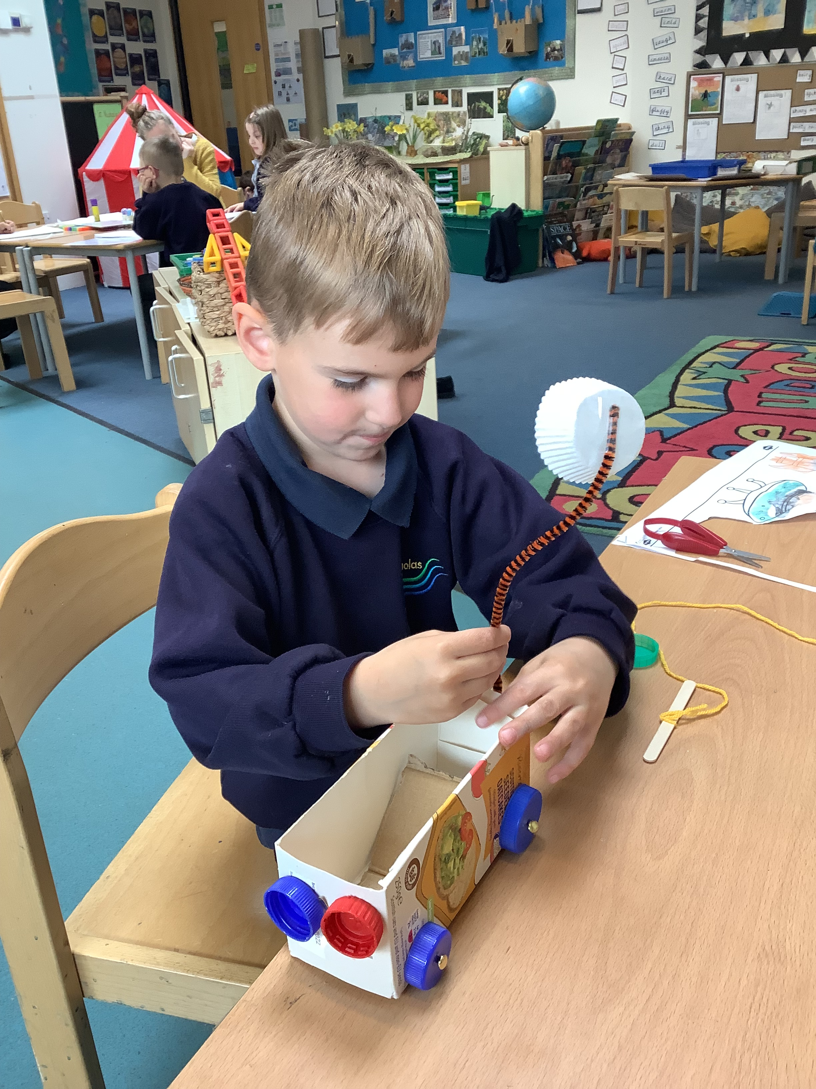
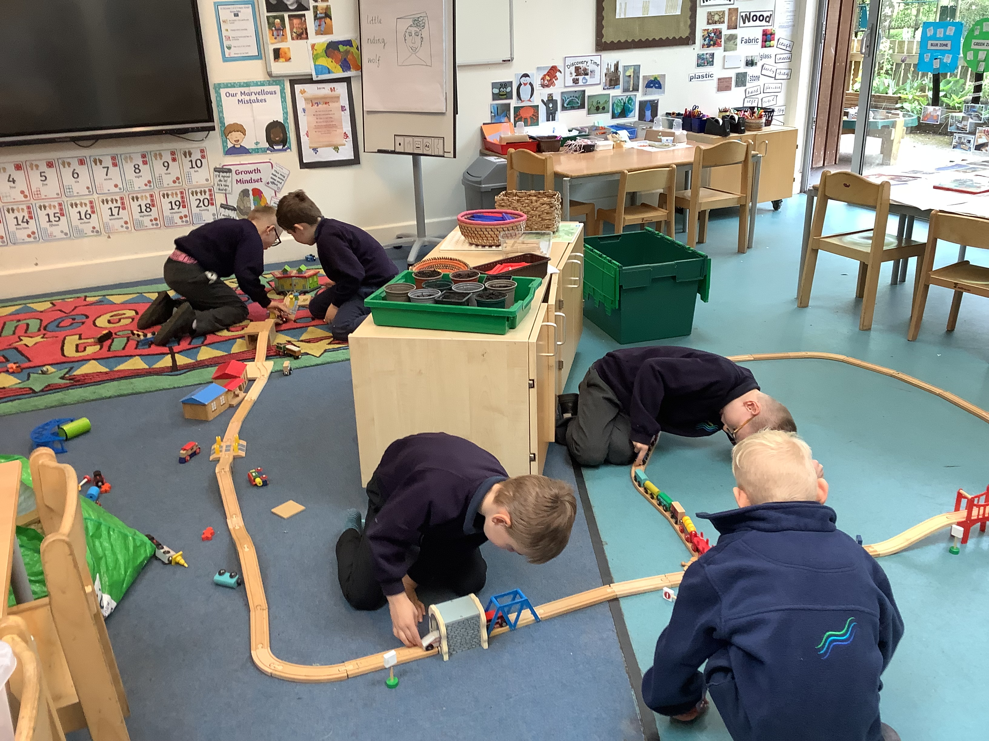
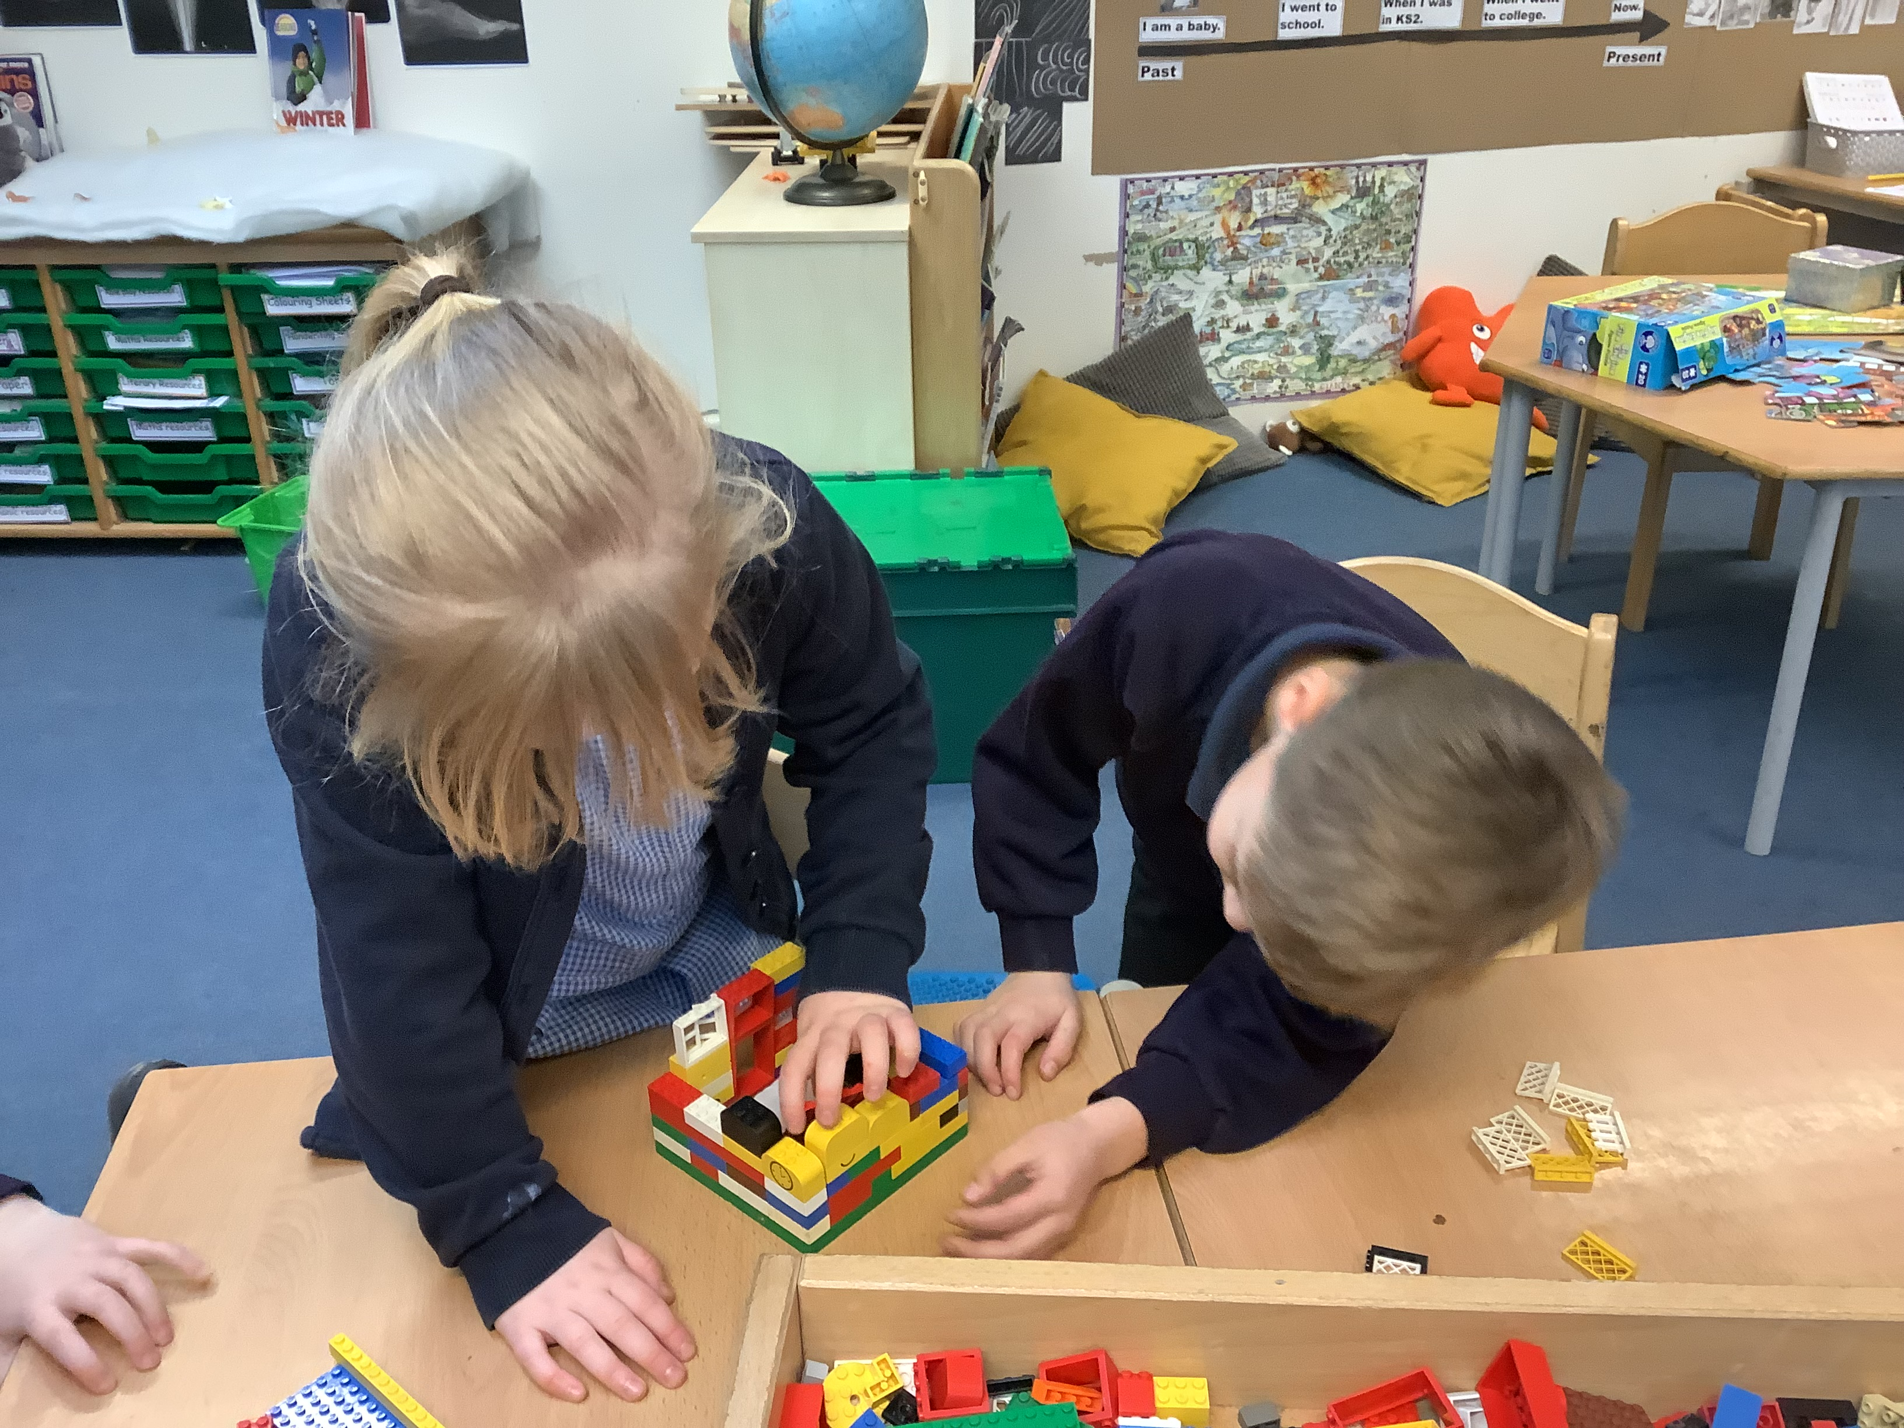
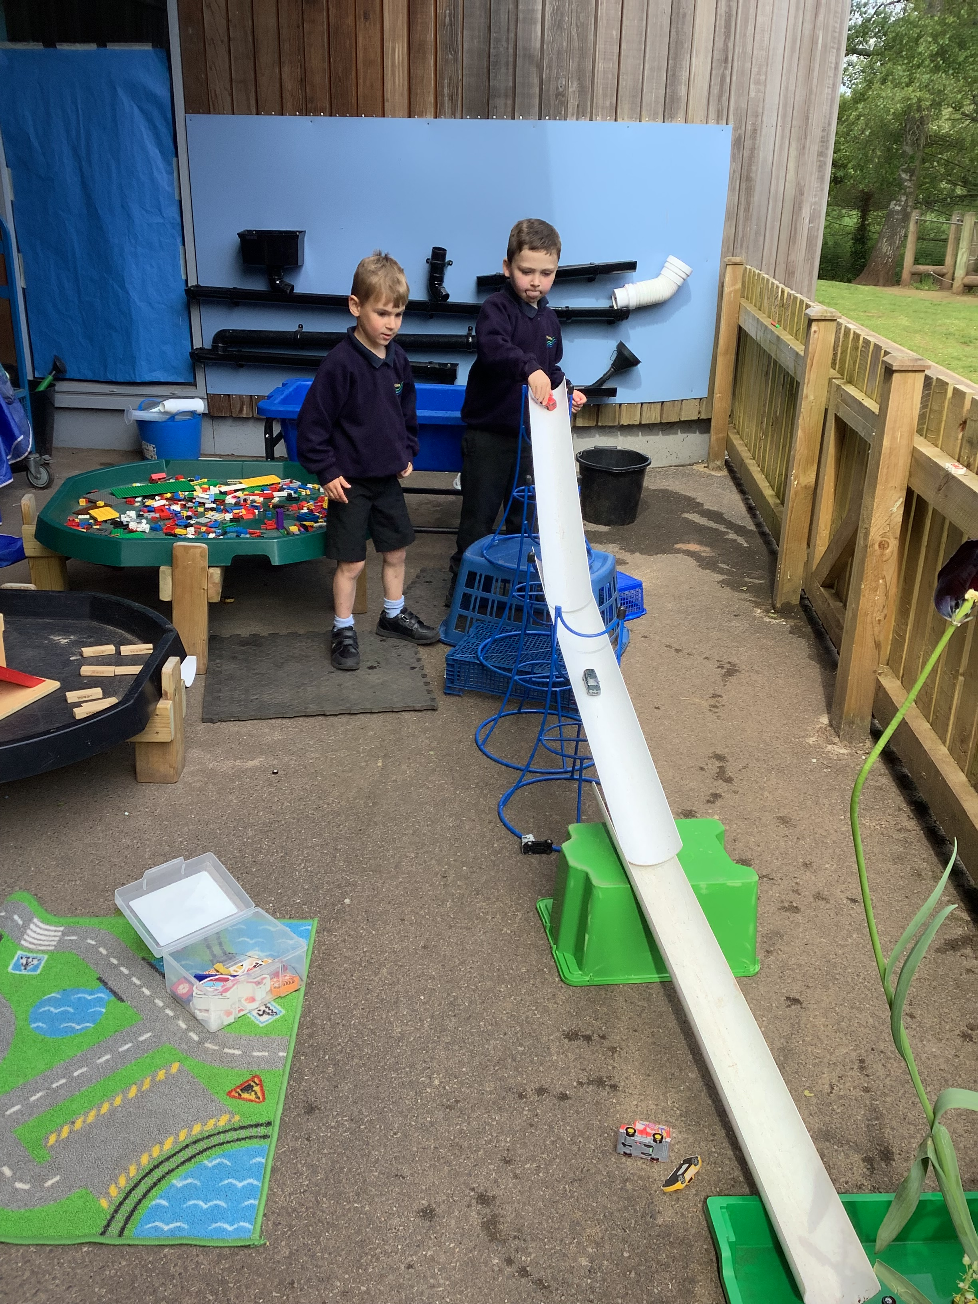
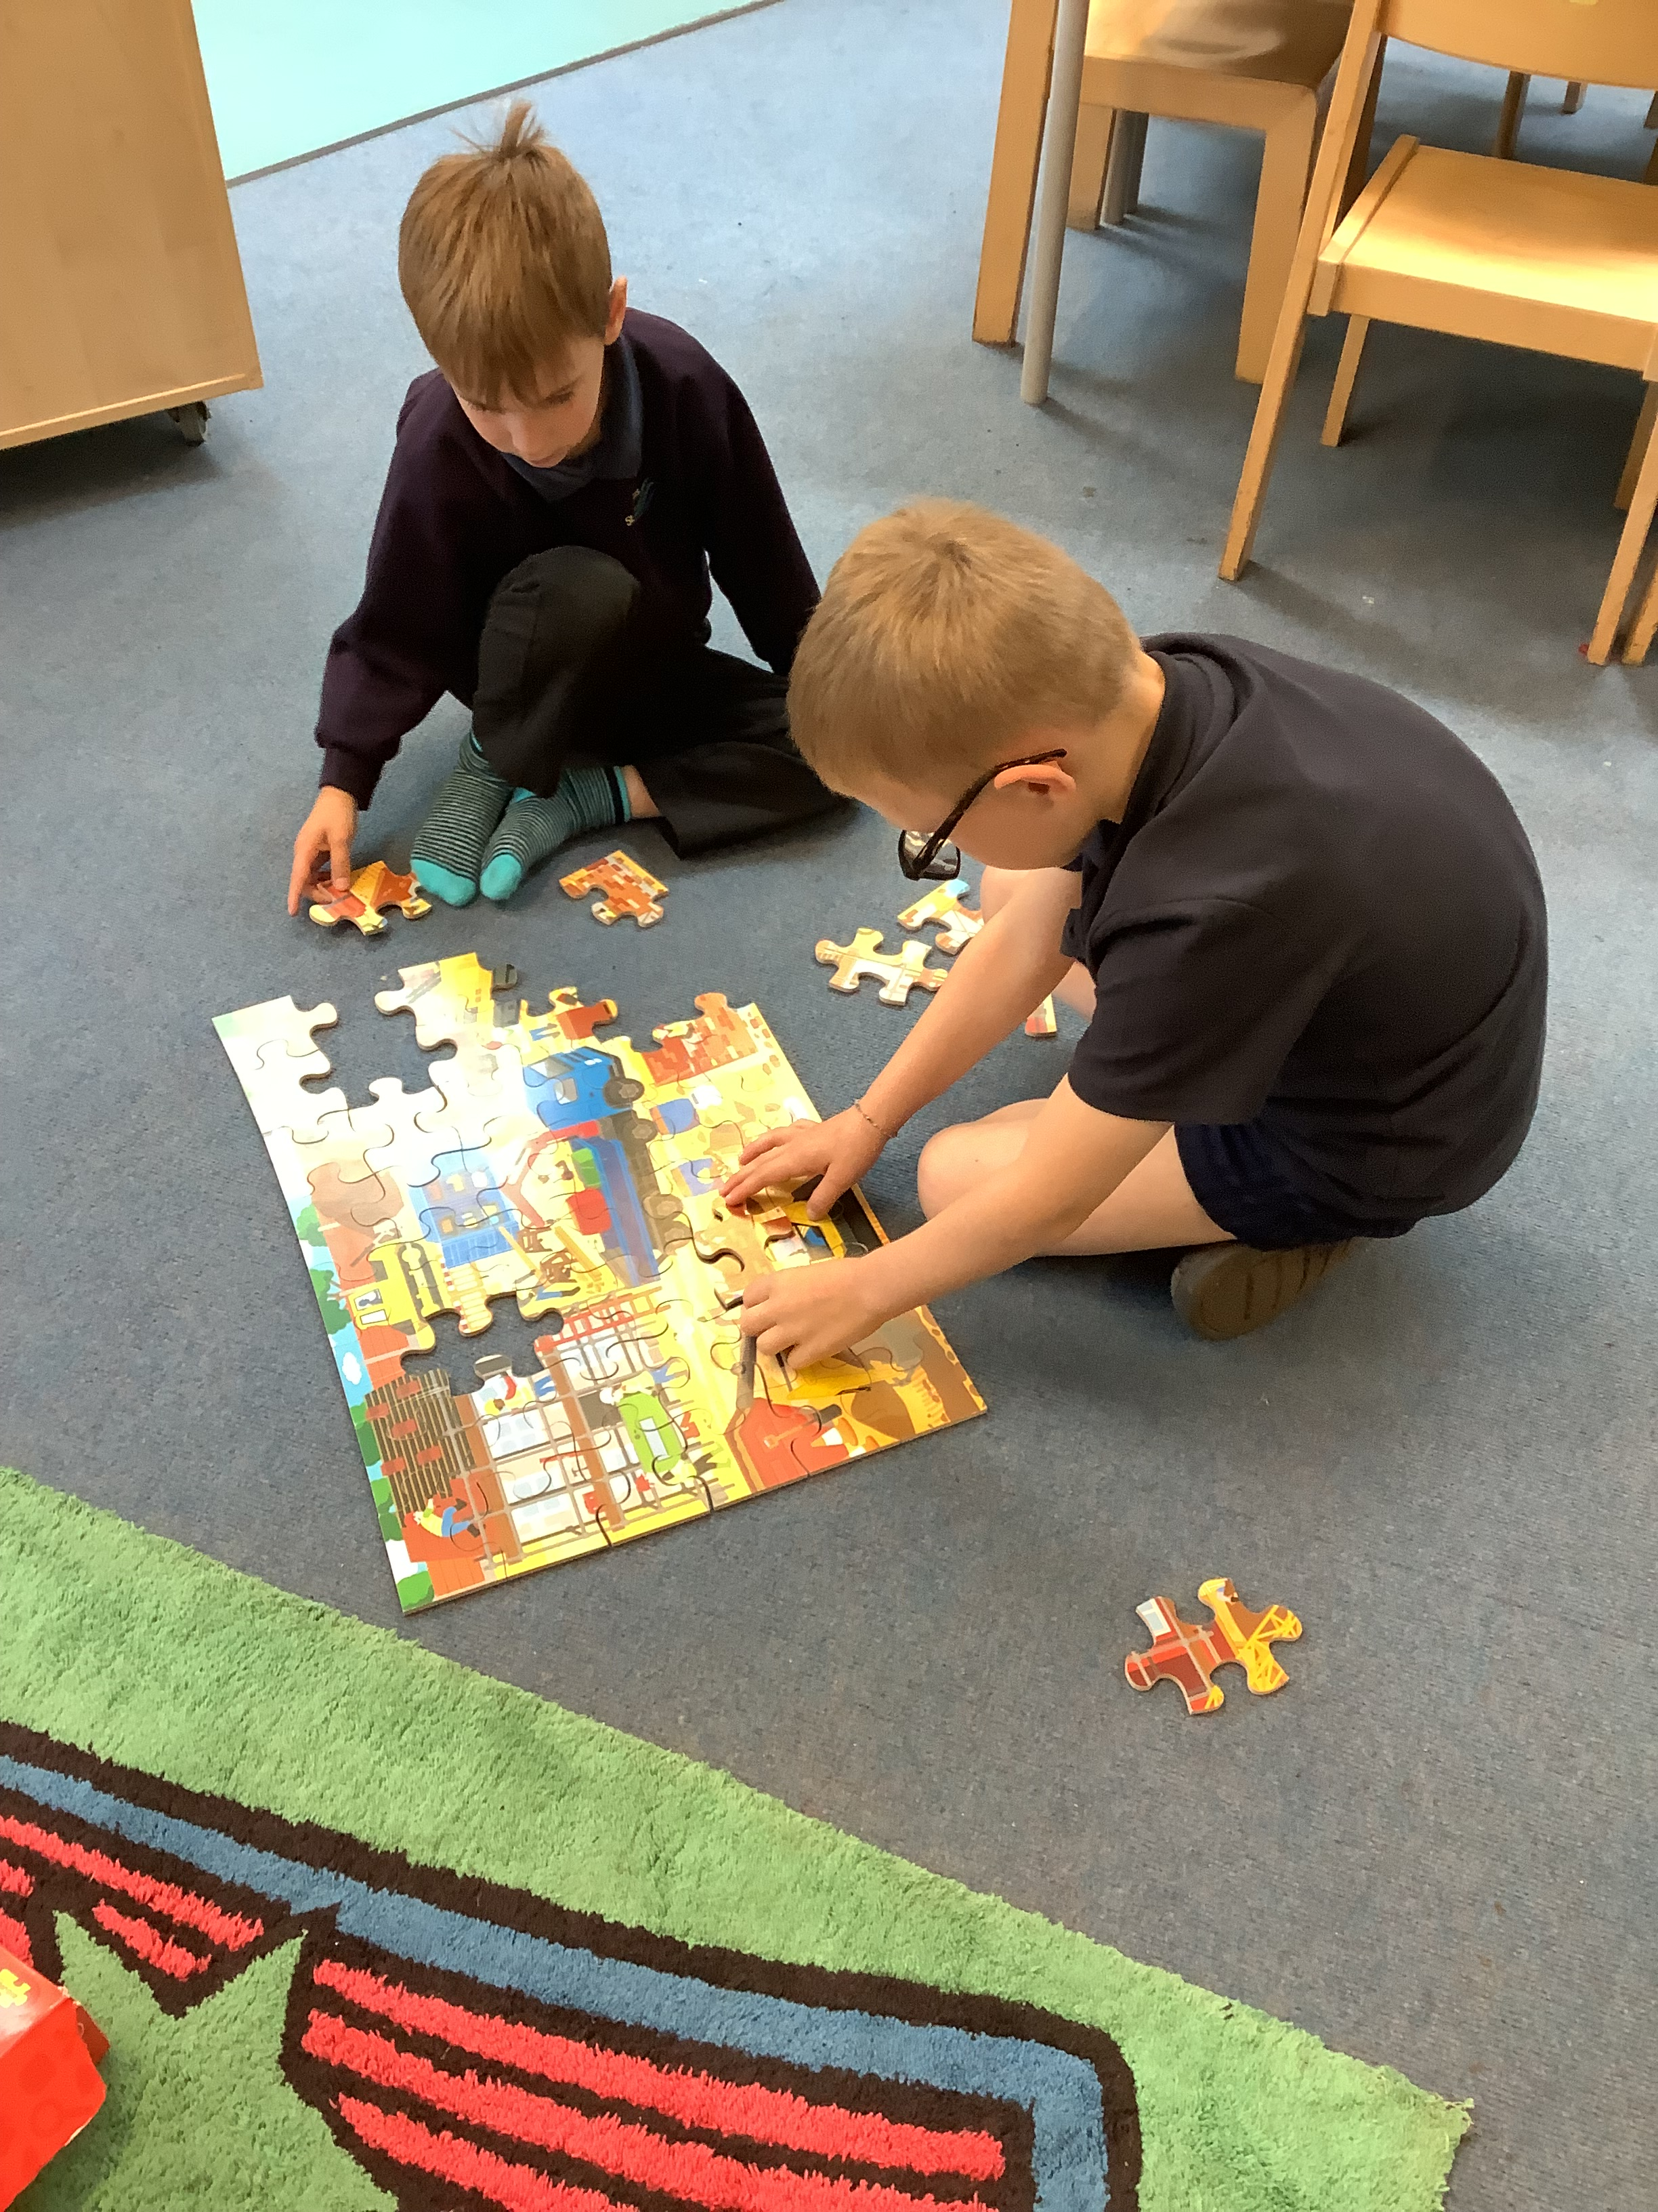
Continuous Provision
Children develop:
Independence.
Social skills: Co-operation/ negotiation
Imagination. Taking on different roles and creating different scenarios.
Communication.

Slide 8
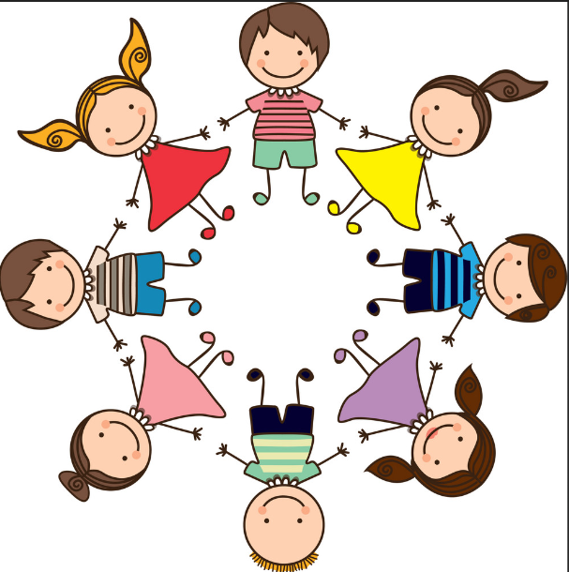
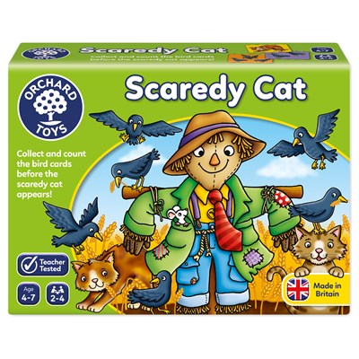
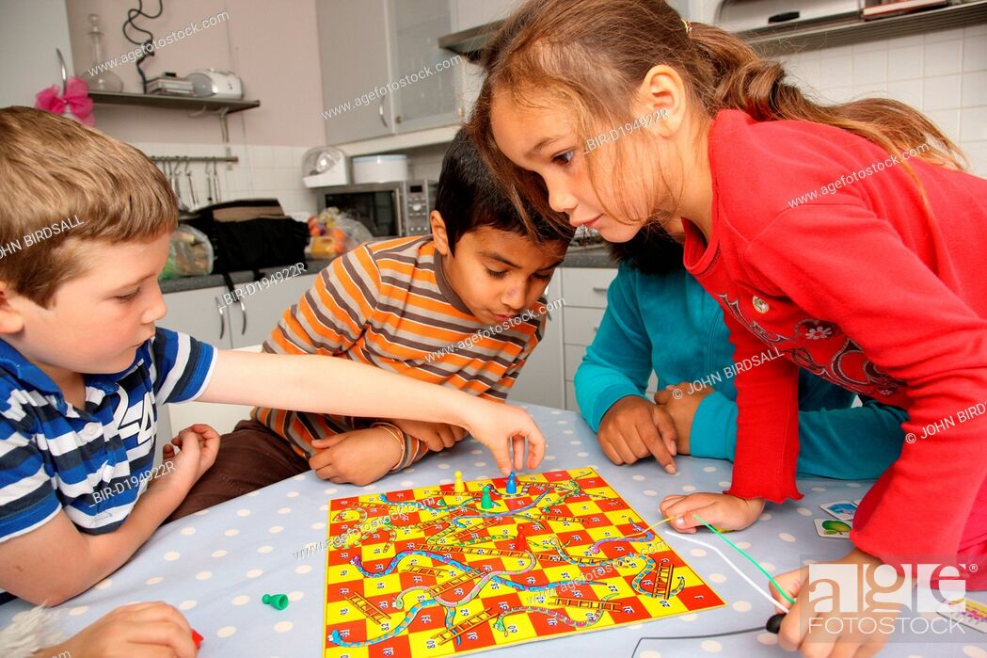
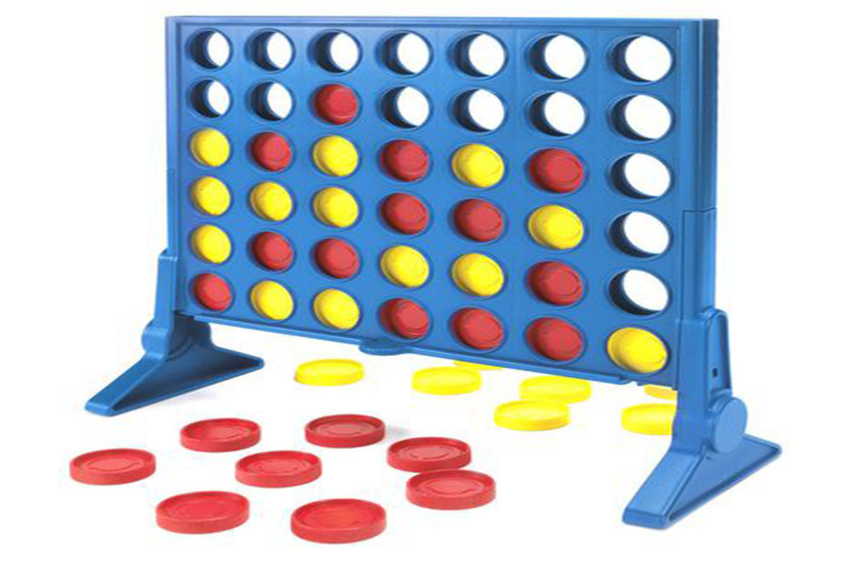
Playing games
In Wellow Class we often spend time playing games such as, Snakes and Ladders, Frustration, Connect 4, Happy Families, Snap, Pairs, Scaredy Cat as this helps children to develop skills of:
Turn taking.
Co-operation.
Waiting their turn.
Boosting self-esteem and teaching them how to win and lose gracefully.
Speech and Language.
Following instruction.
Mathematics.

Slide 9
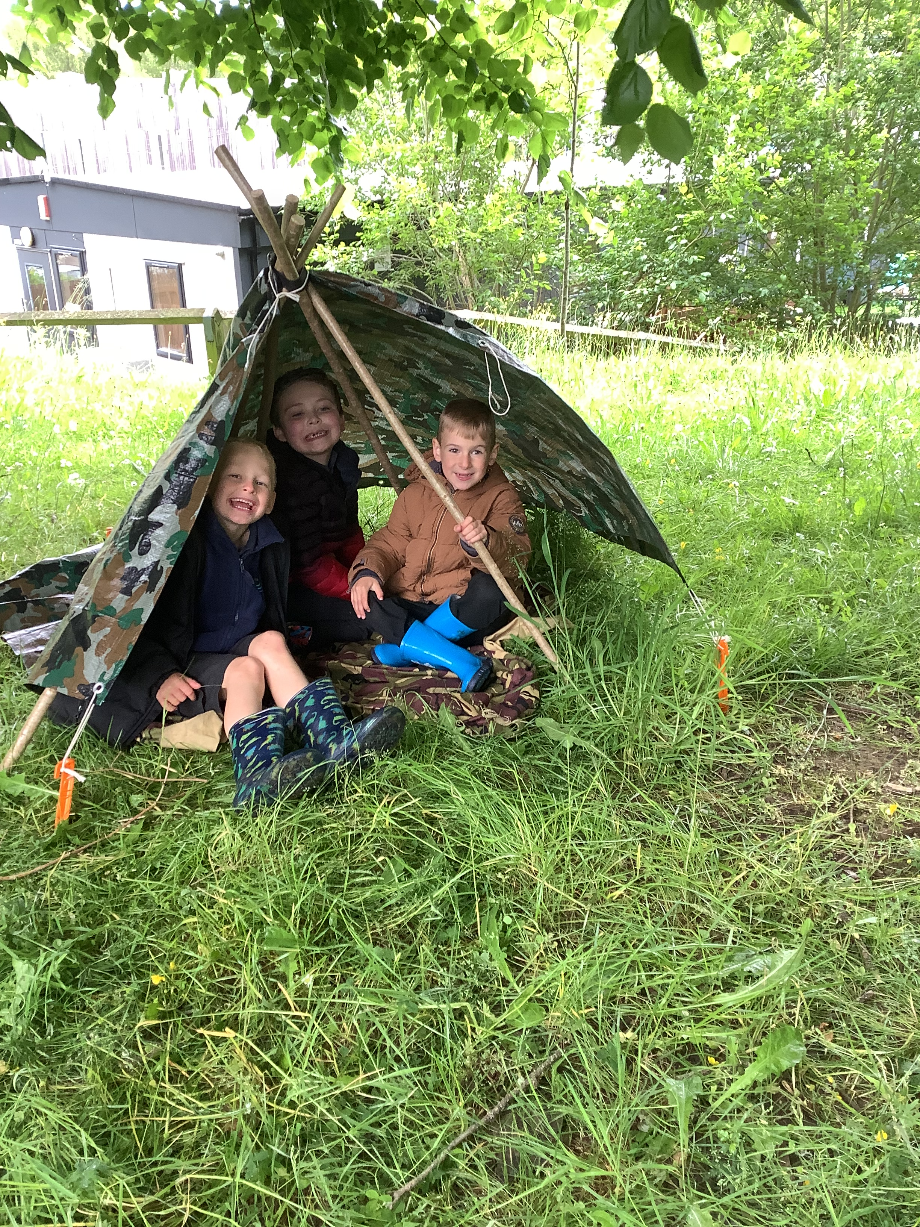
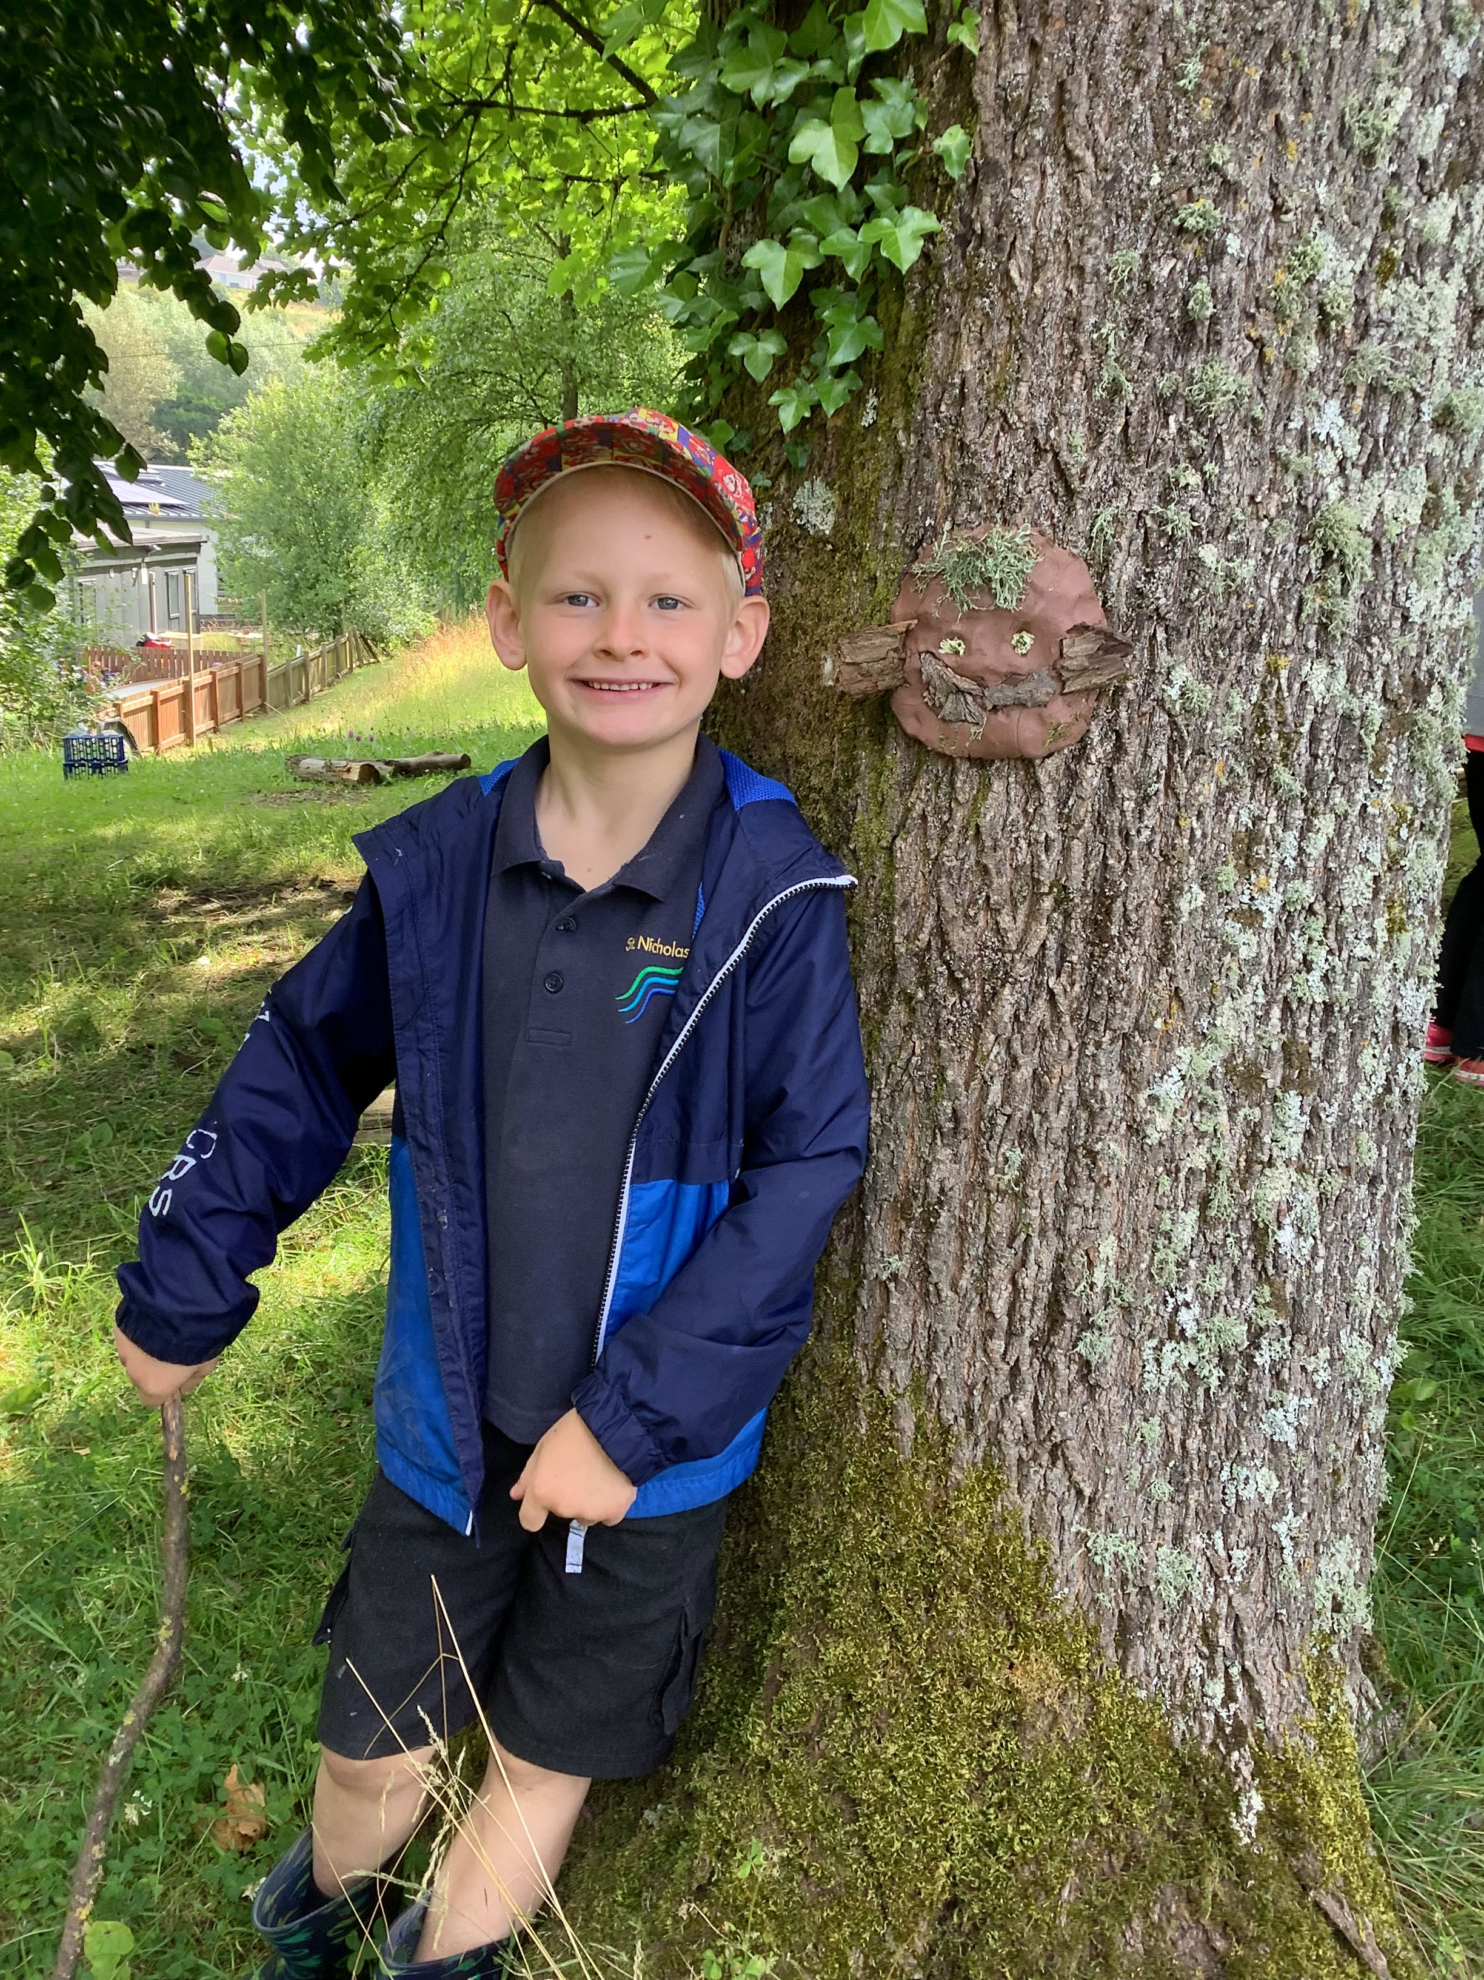
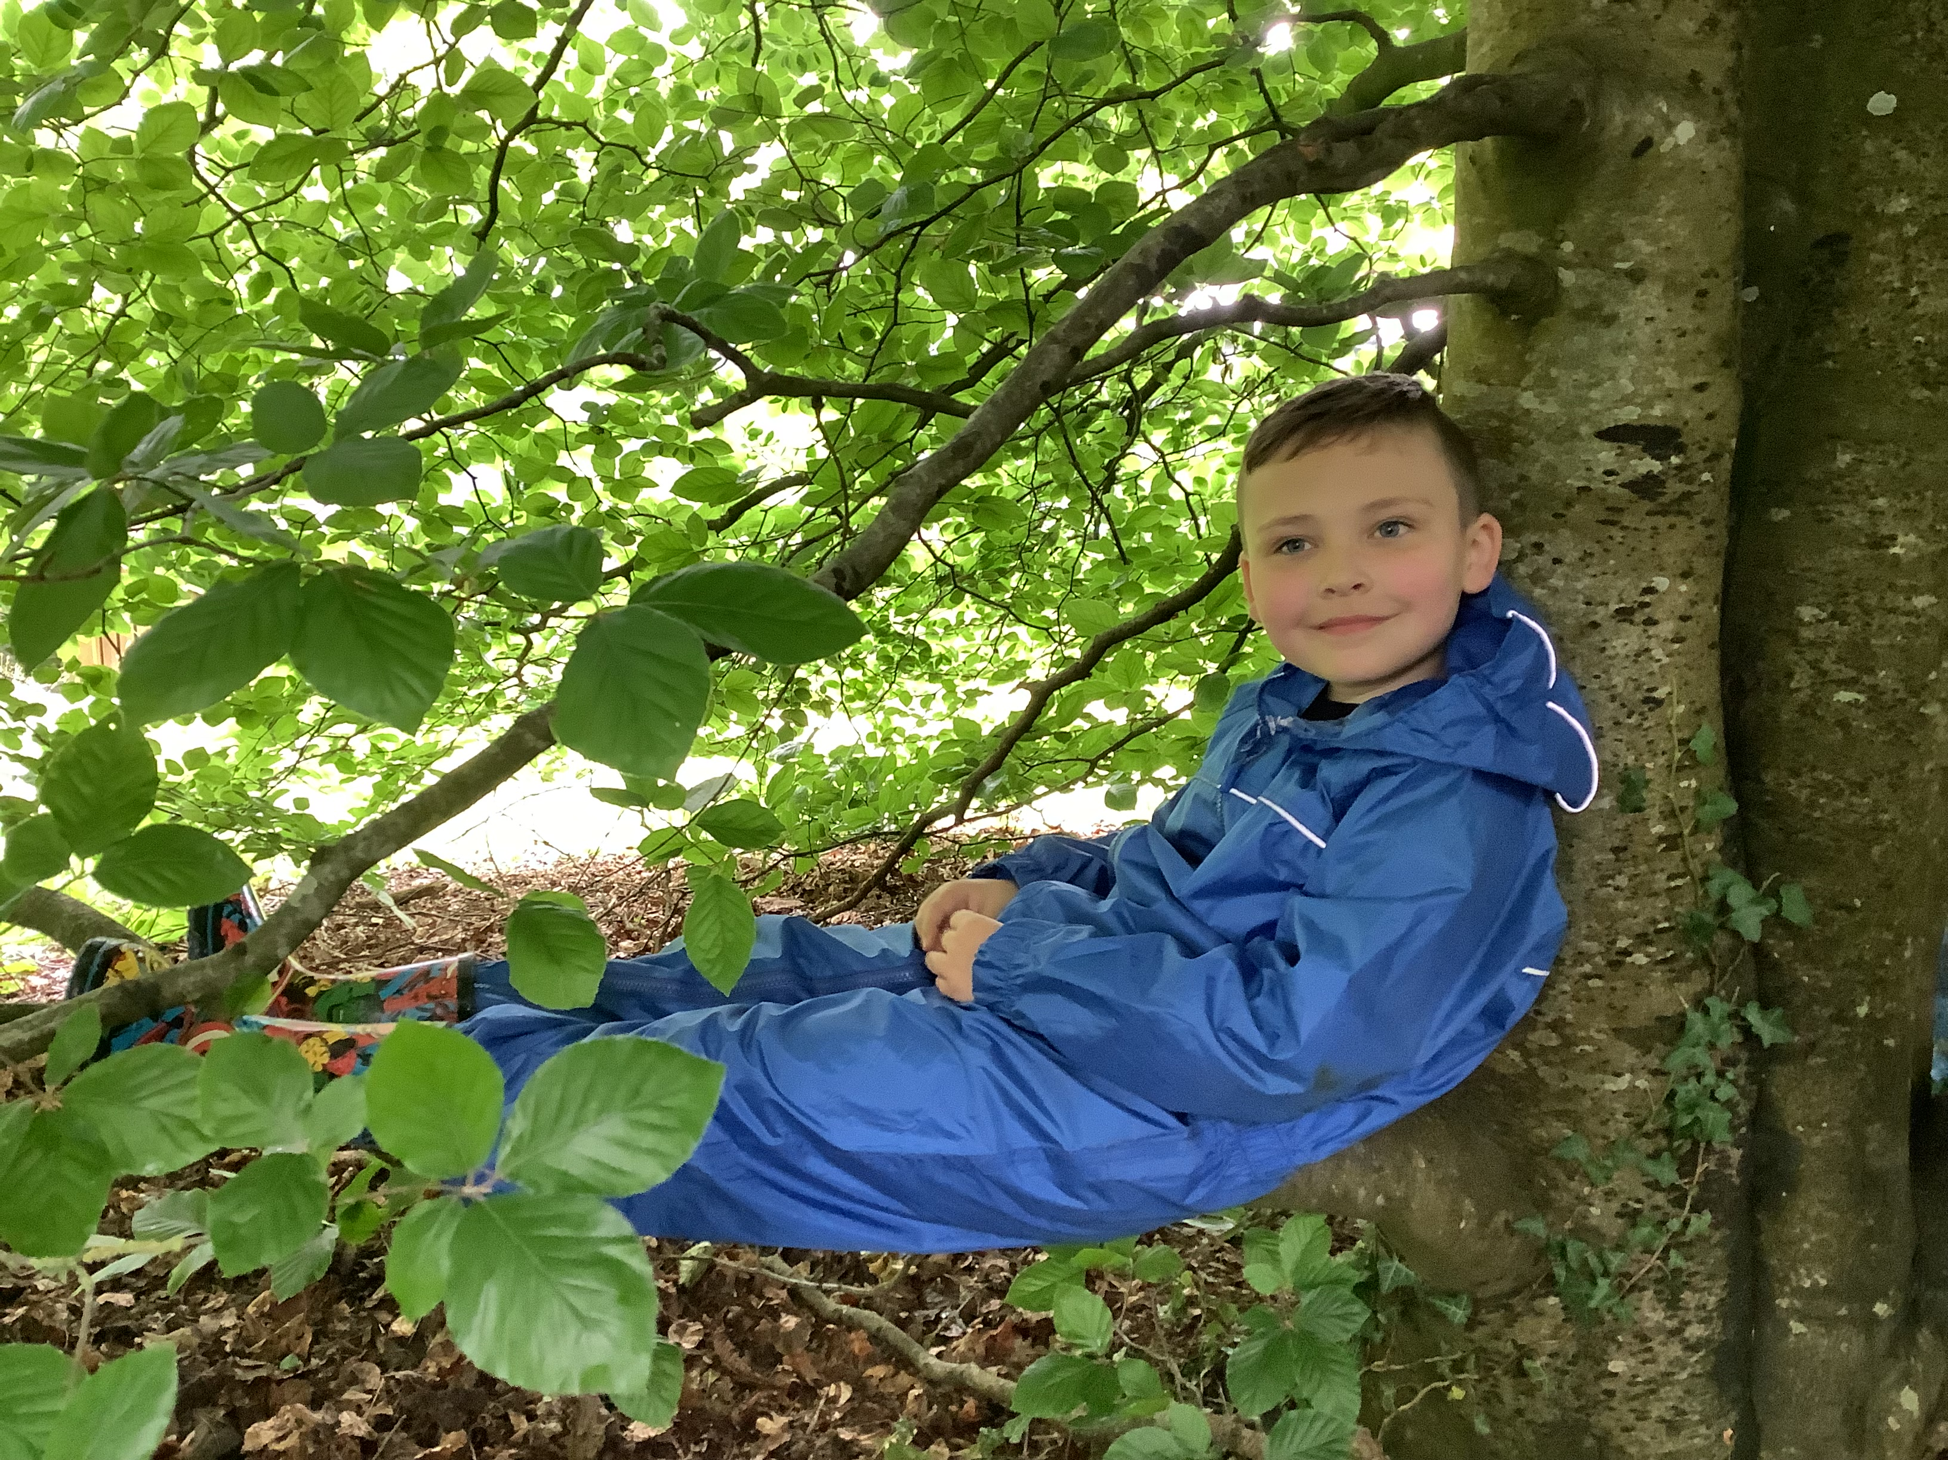
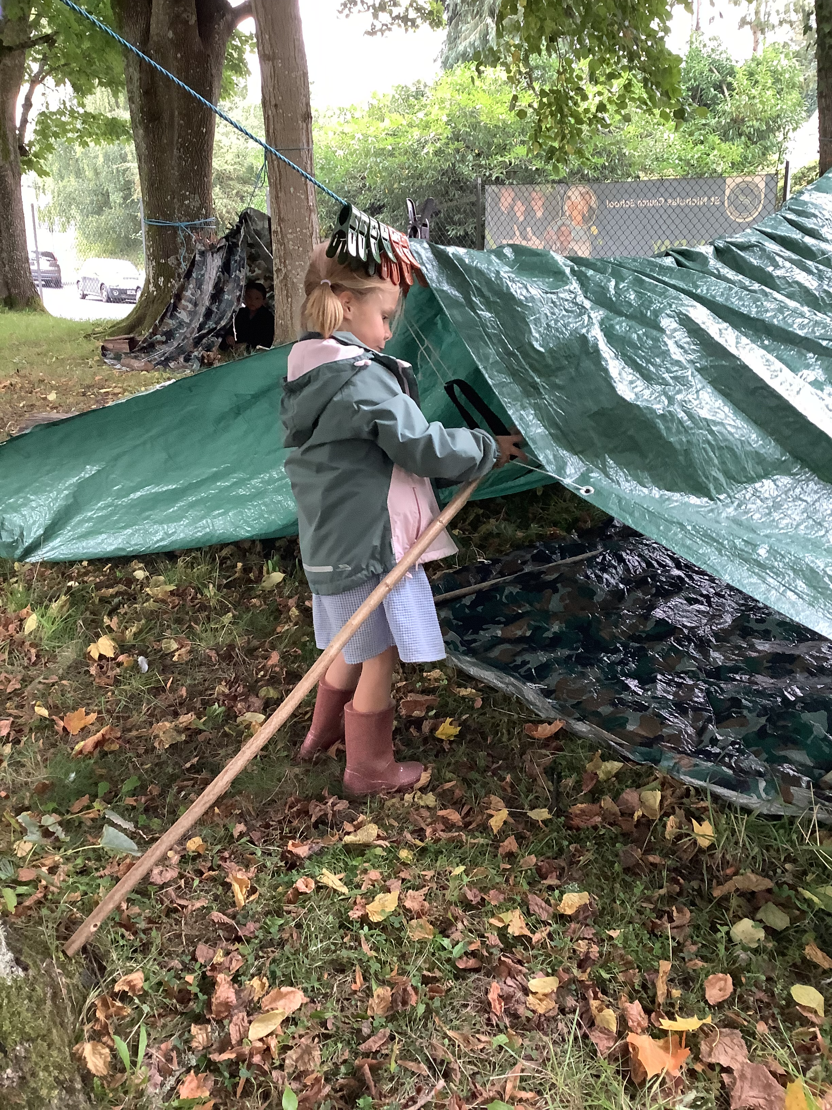
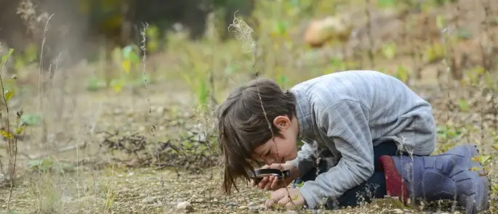
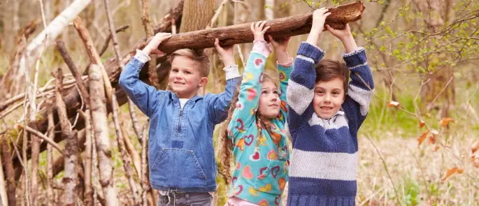
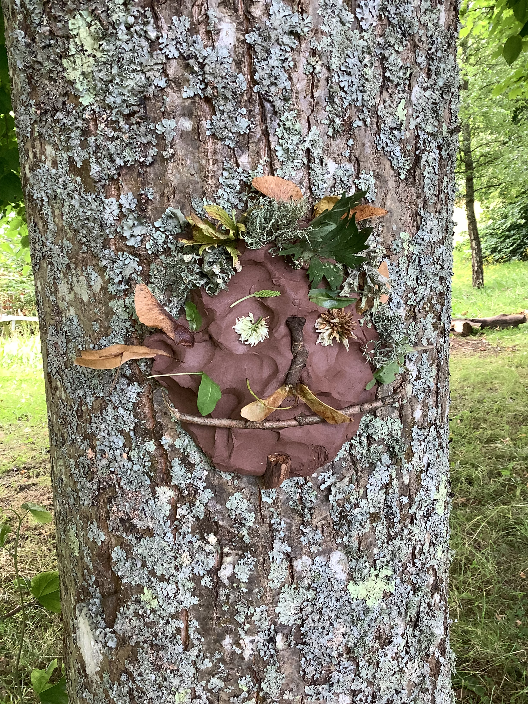
Forest School
Children in Wellow Class regularly have access to the forest area within the school grounds. We have found children benefit enormously from time spent in the natural world.
Forest School sessions can:
Develop greater curiosity of the world around them.
increase a child's self-esteem through exploration.
Build resilience.
Provide opportunities for problem solving and risk taking.
Enable children to work co-operatively.
Encourage communication and develop language.
Increase motivation and concentration.
Improved overall well-being and mental health.

Slide 10
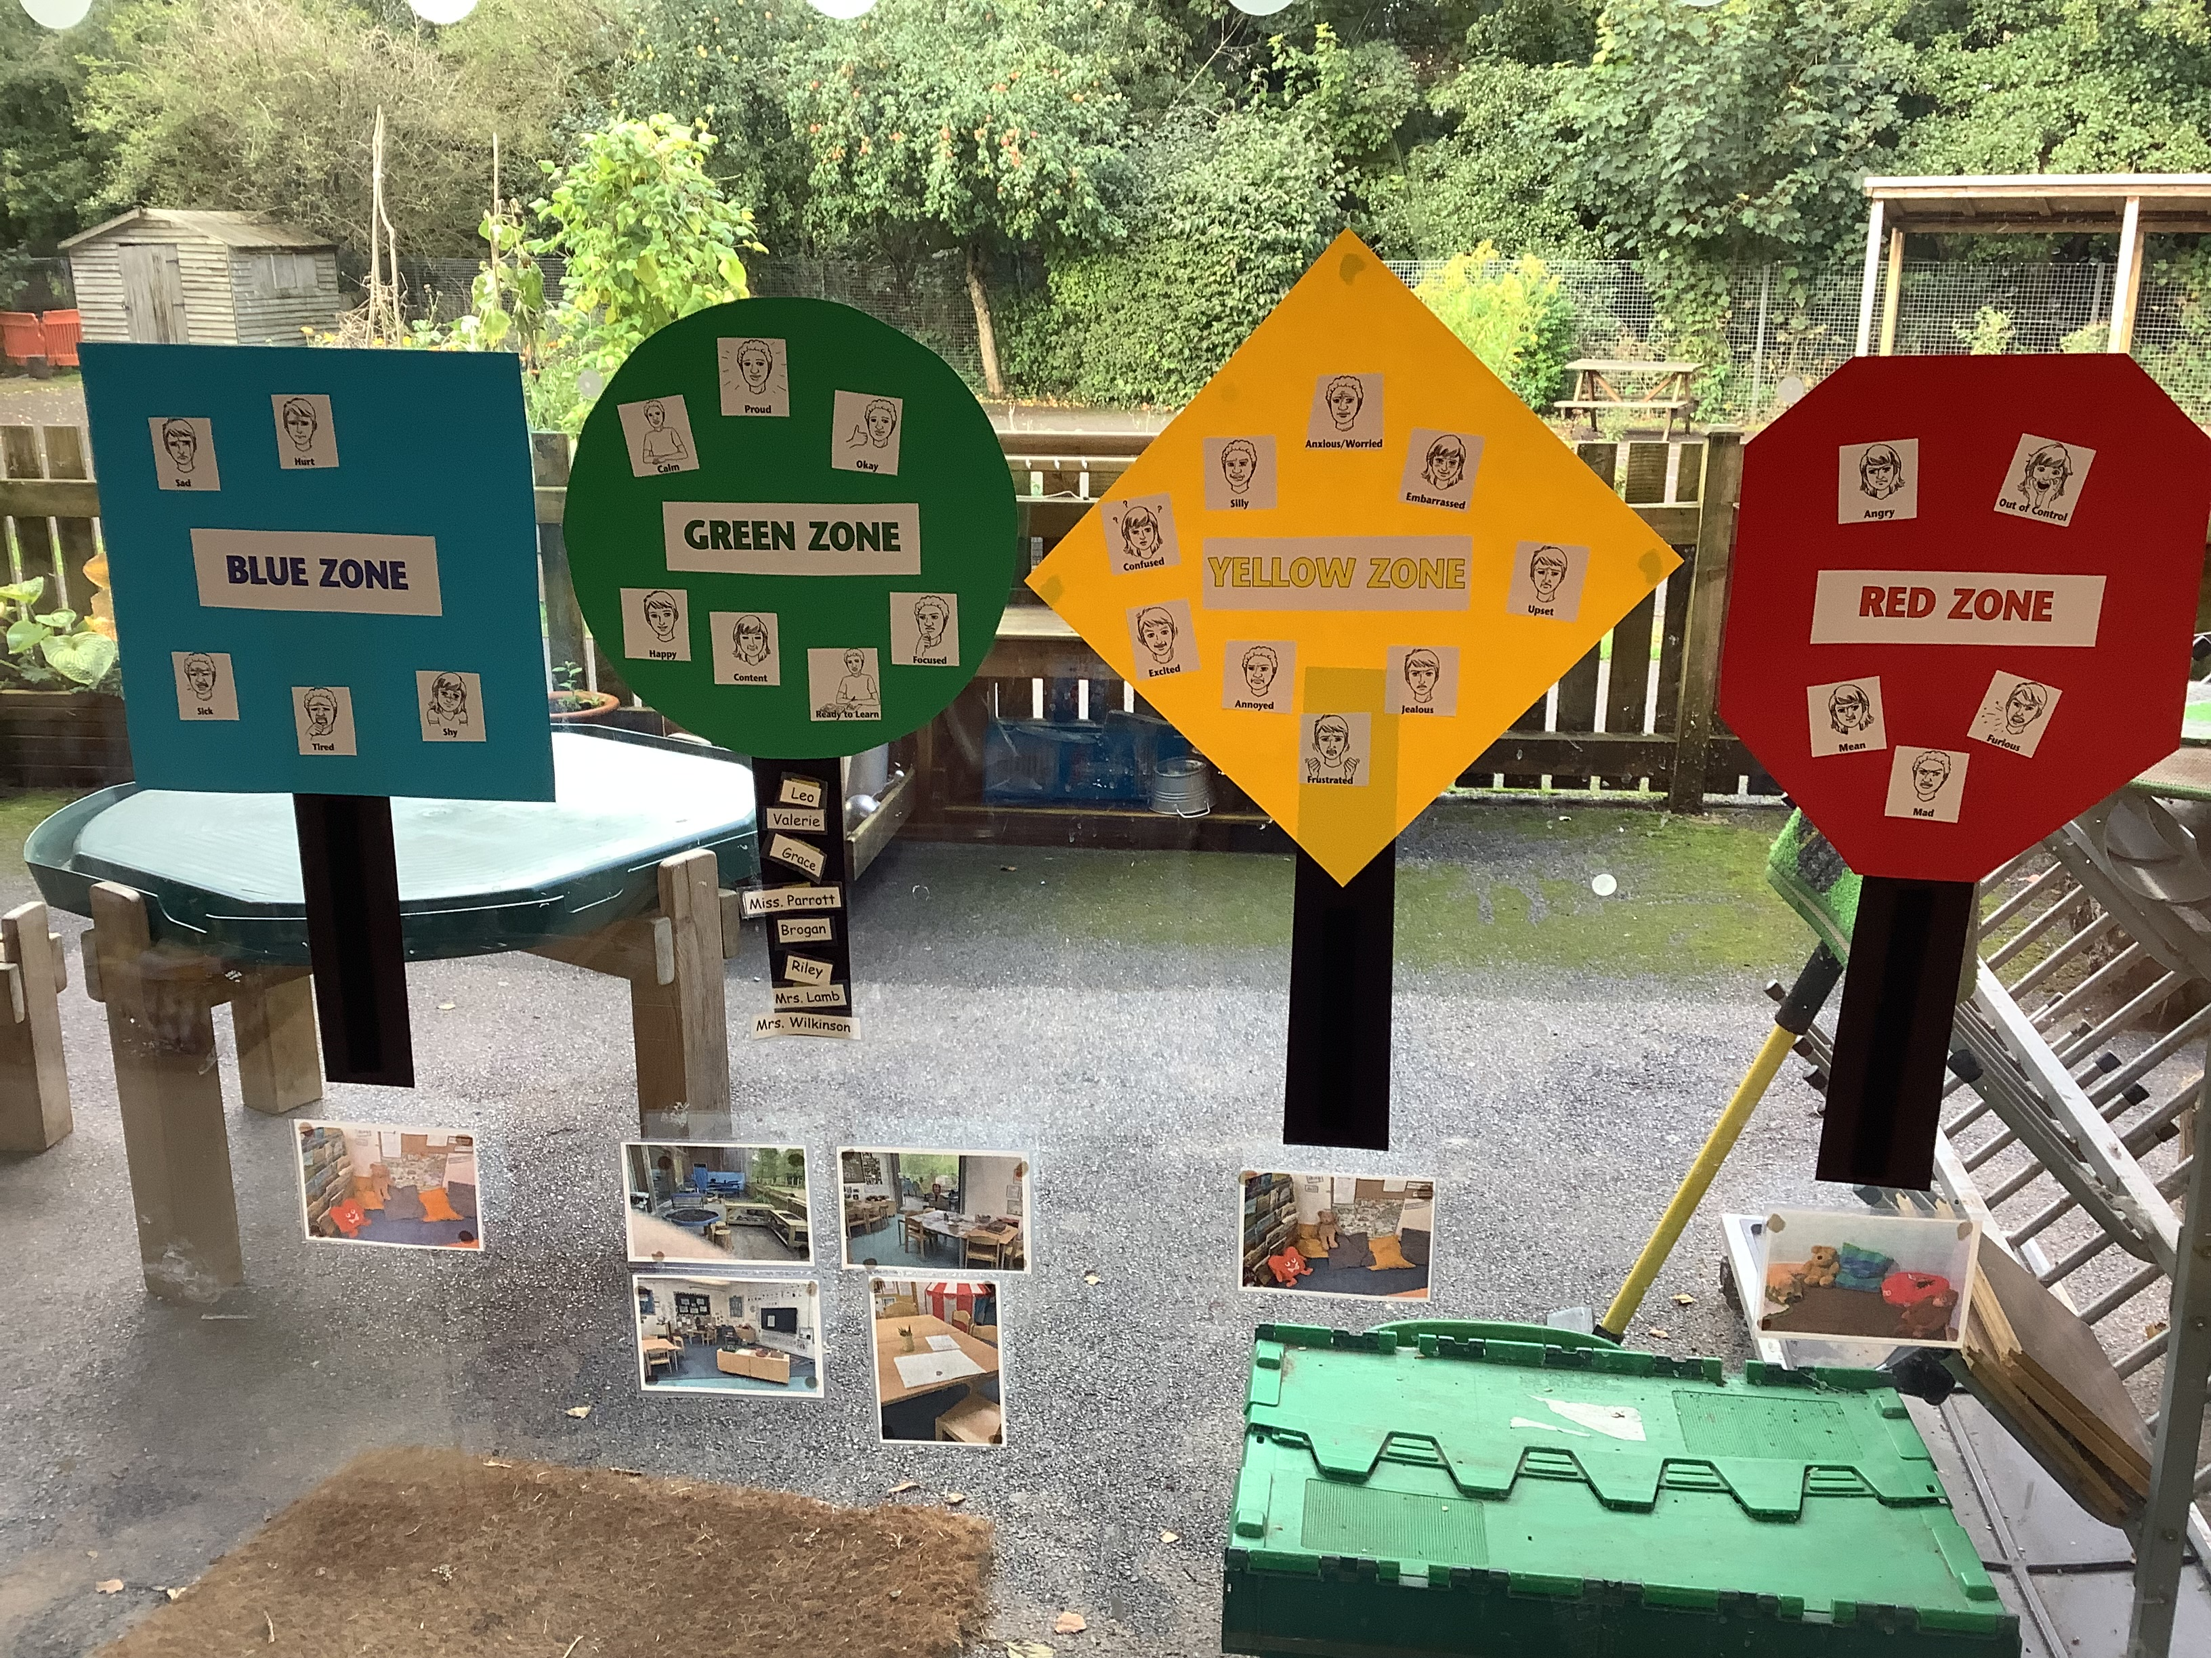
Zones of Regulation

